Slide 1
Magnet development for future colliders and test facility for US fusion program
April 17, 2026
Gueorgui Velev
Senior Scientist, Deputy Director of the US Magnet Development Program
Deputy Division Head of Magnet Technology Division
Notes:
Добро утро, добър ден,
Първо искам да благодаря на организаторите на това честване по случай 80-годишнината от основаването на катедра „Атомна физика“ в Софийския университет за поканата да участвувам в него, както и за възможността да изнеса доклад. За съжаление, моят доклад ще бъде на английски език.
През 40-годишната си кариера като физик аз практически не съм работил в България. Материалът на доклада, който обхваща моята работа през последните 5–6 години, съдържа много физични термини и жаргон, които ще ми бъде трудно да преведа правилно на български.

Slide 2

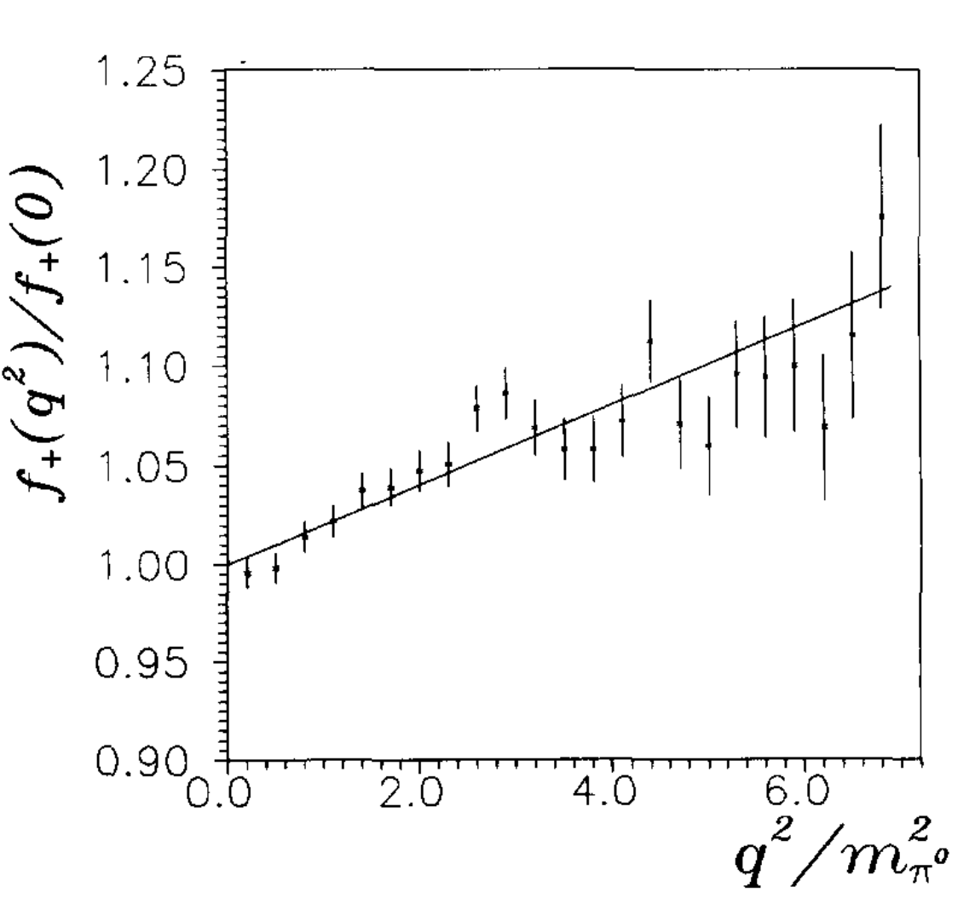
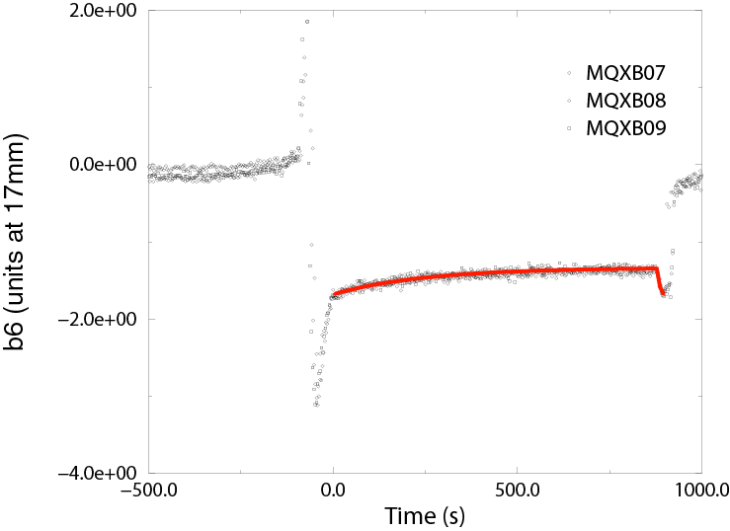
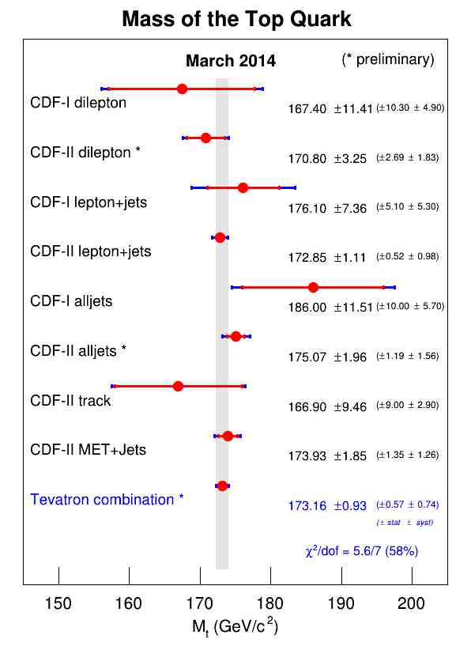
My career
Career Highlights
Dubna – March 1986 – June 1993 (A. Jordanov, R. Tzenov, L.Litov)
Graduation thesis (Prof. L. Litov) – Sep 1986
PhD (Dec 1992): Form factors of the semileptonic decay K⁺ π⁰ e⁺ ν
  Most accurate measurement of form factors until 2002 (PDG)
1991-1997 – BAS Computing Center
Postdoc (1994–1998), INFN Pisa – CDF
  Measurement of the top quark mass
Associate Scientist (1999–2004), Fermilab – CDF
  Top quark mass measurement
  SC magnets and IR quadrupoles for LHC
Scientist (2004–2010), Fermilab
  Top quark physics (CDF)
  Group Leader, Magnet Accelerator Support Group
Senior Scientist (2010–present)
  CDF (until 2015): most accurate top quark mass measurement (pre-LHC era)
  SC magnet R&D: field effects control (“decay and snapback”)
Deputy Director, U.S. Magnet Development Program (2017–present)
Project: Fusion test facility at Fermilab (2019-present)
Leadership roles:
  Department Head/Sector Head
  Deputy Division Head, Magnet Technology Division
  Managed SC magnet R&D at Fermilab (2017–2023)
2. Fermilab Test Facility for U.S. Fusion Programs

Slide 3
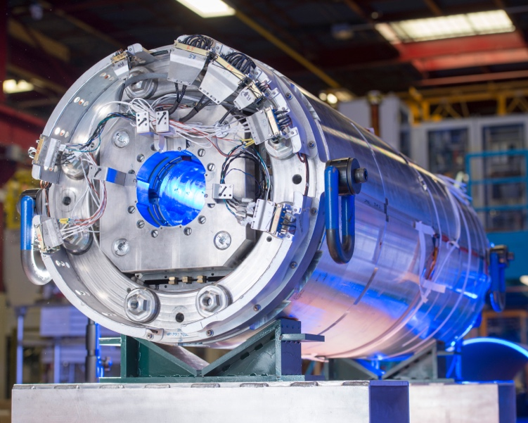
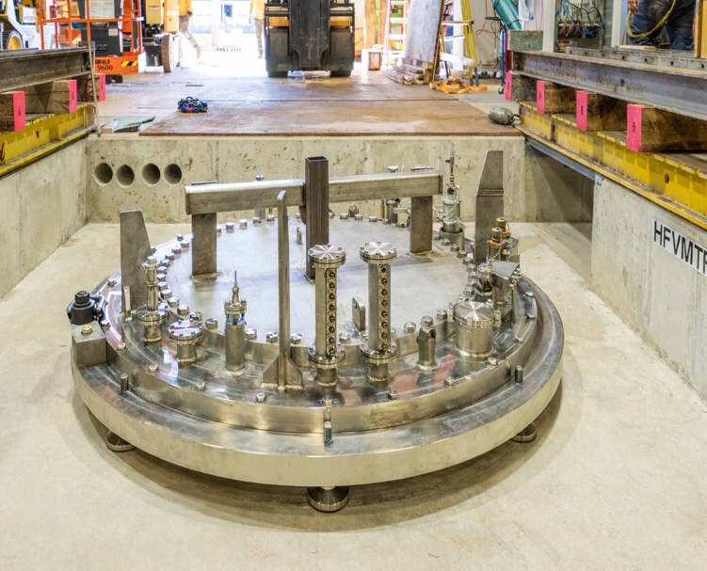
Outline
1. U.S. Magnet Development Program
Magnet needs of future colliders
The US Magnet Development Program
Recent major accomplishments
Short Summary
2. Fermilab Test Facility for U.S. Fusion Programs
Summary of the test facilities
New test facility at Fermilab
  Parameters and operational modes
  Status
    Test pit construction
    Cryostat
    Quench protection and monitoring systems (QP/QM)
    Power supplies
15 T dipole (TFD) and test insert, cable (sample) holder, anti-cryostat design
Short Summary

Slide 4
U.S. Magnet Development Program
01

Slide 5
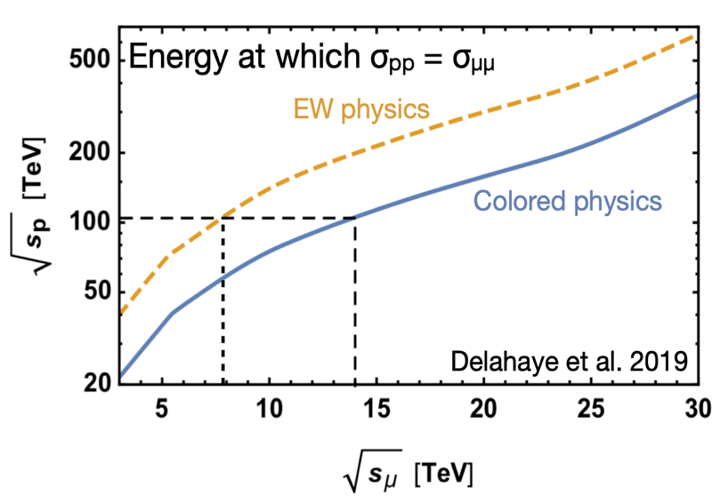
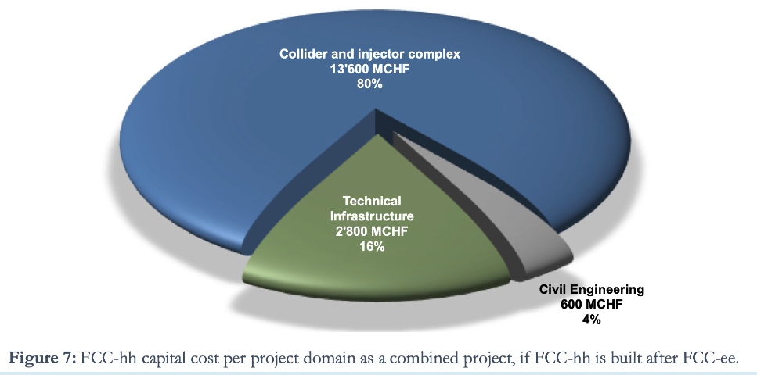
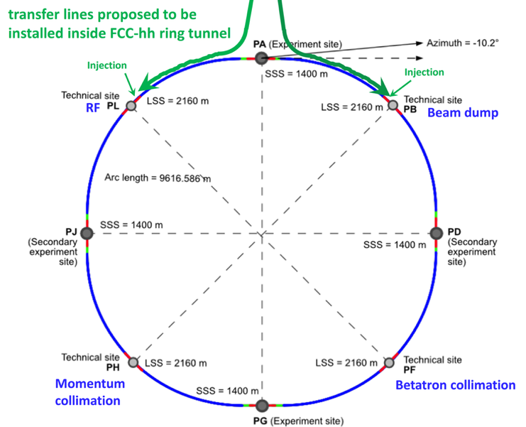
Hadron and muon colliders - energy frontier options
Magnets are ~60% of Collider & Injector, ~50% project
Future HEP Colliders
The U.S. Particle Physics Project Prioritization Panel (P5) endorsed two major machines for the future of the field:
  FCC-ee, and consequently FCC-hh at CERN
  Muon μ⁺ μ⁻− collider, to be built in the U.S. (most likely at Fermilab)
https://arxiv.org/pdf/2203.07256
Muon collider
FCC-hh collider

Slide 6
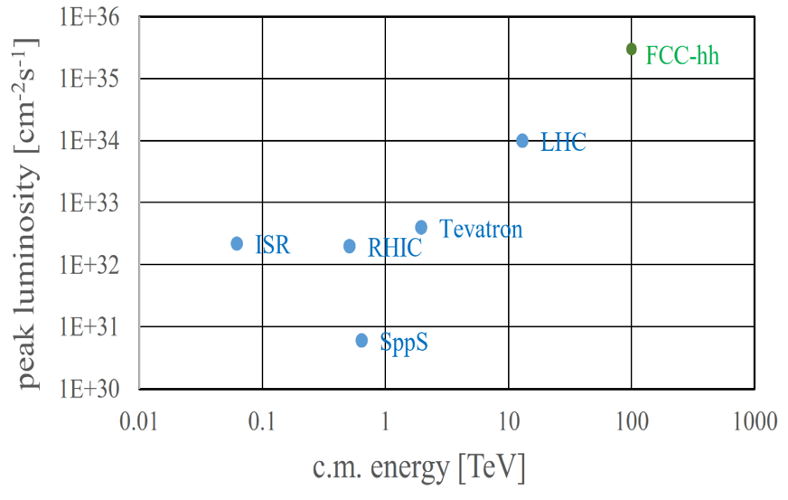
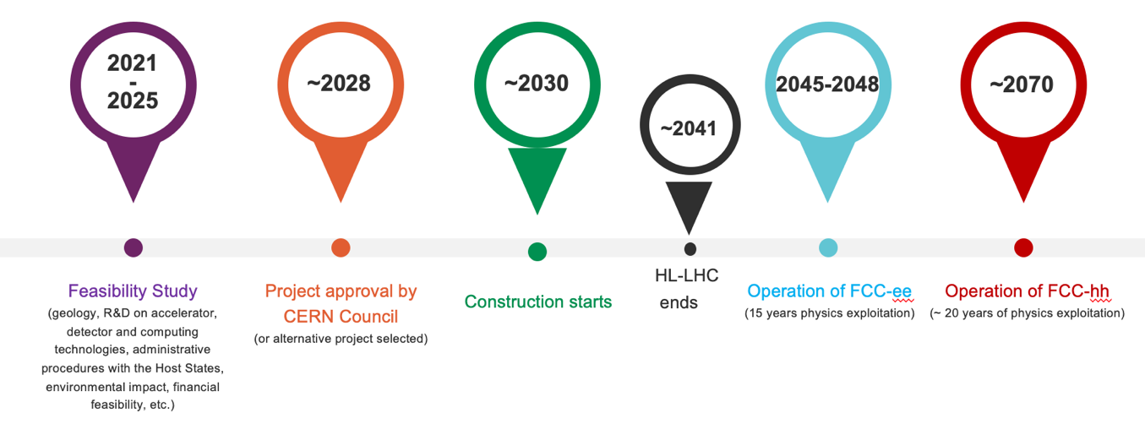
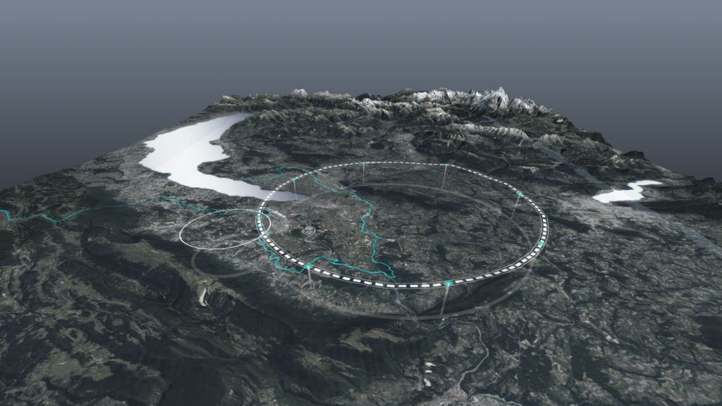
Possible future hadron collider – FCC-hh at CERN at CERN
~100 TeV CM collision energy (~10 TeV pCM)
  20 ab⁻¹ per experiment over 25 years
  Order of magnitude increase luminosity vs LHC
  Luminosity per IP: ~30x10³⁴ /cm²/s
  Site Power ~500 MW
Uses FCC-e⁺e⁻ tunnel
  With very high-field SUPERCONDUCTING magnets based on Type-II SC
  Develop: 14-20 T magnets
Type-II SC
Credit: F. Zimmerman, V. Shiltsev, P5 town hall at SLAC

Slide 7
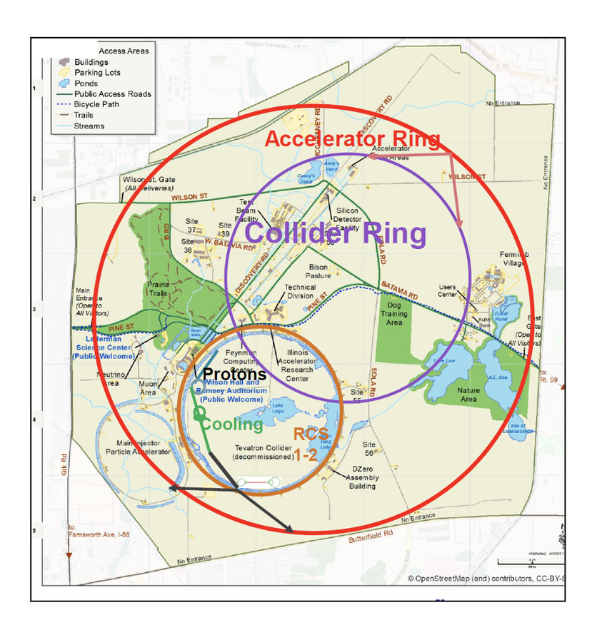
Muon collider - critical advances in magnet technology
Pros:
  Colliding elementary particles
  Lower beam energy than proton–proton machines for the same center-of-mass parton energy, relatively low synchrotron losses
  Site Power ~ 150-300 MW
Cons:
Radiation is a major consideration:
  Study tradeoff in aperture/bore+shielding vs magnet radiation hardness
  Further advance understanding of radiation hardness of superconductors and magnet materials
Rapid acceleration is critical (at 10Tev ~ 200 ms):
  Study fixed-field booster options where applicable
  Further investigate high dB/dt magnet concepts (dB/dt ~ 4000 T/s)
  Evaluate acceleration (particularly low-energy) schemes in an integrated approach
Large thermal loads suggest higher-temperature operation
  Explore all-HTS option
  Explore facility and operational cost models
Leverage strong synergies with fusion and High-Field magnets:
  Fastest development path for very challenging target and cooling magnets

Slide 8
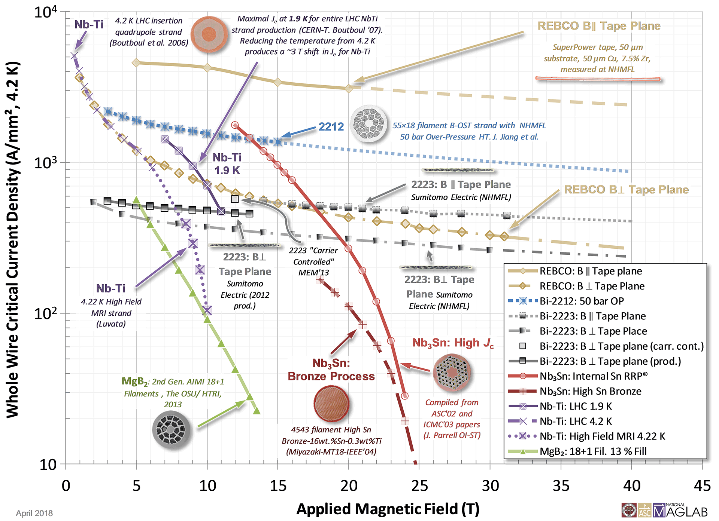
The US MDP organization
Hybrid magnet – LTS + HTS coils
It is a R&D program funded of DOE Office of Science. Central focus: develop and test high field magnets for HEP
Improve integration for hybrid magnets
Investigate HEP-motivated solenoid designs
Support magnets with critical materials, expertise & dev. of new enabling technologies
Strengthen linkage between technologies and magnets
Forward looking – what is enabled by our advances, and what is achievable for colliders
Align with, and support, collider design efforts
Further build collaborations, leverage synergies with US fusion

Slide 9
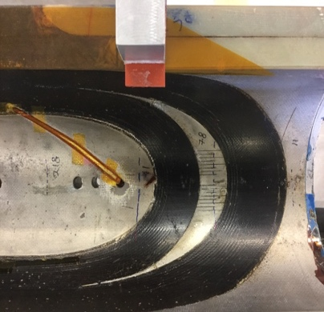
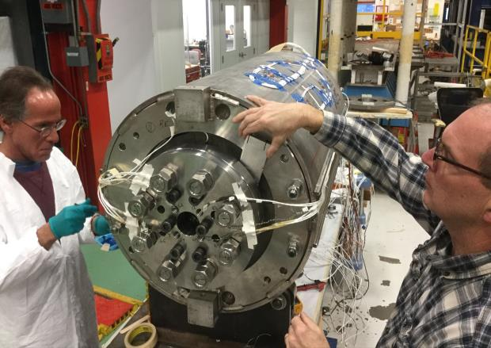
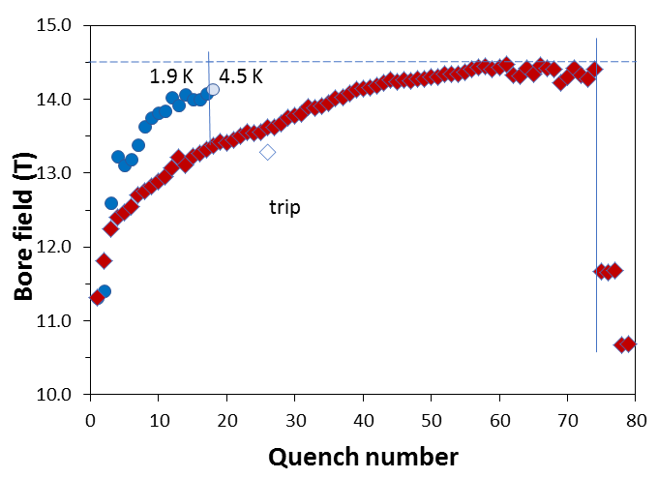
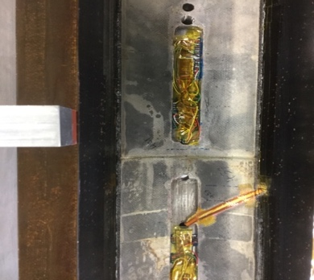
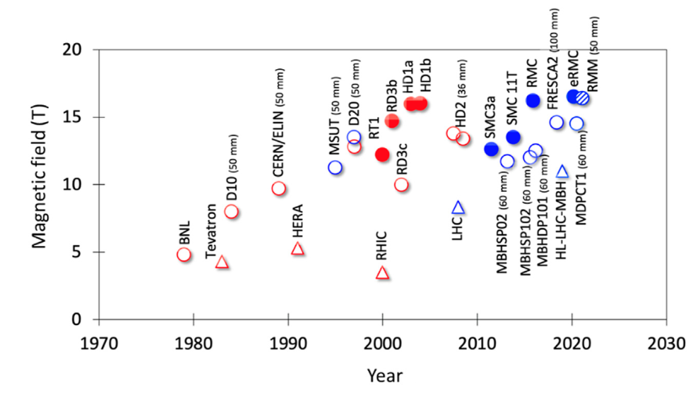

World MDP result - the 14.5T Nb₃Sn dipole
FNAL 14.5T “MDPCT1”
14.5 T world record for accelerator-type dipole magnet
II
III
I
MDP Perspective:
Highest priority issue: degradation mechanisms; design mitigation
Second priority: Initial quench current and memory after thermal cycle
Third priority: Training rate
A. Zlobin et al, doi: 10.1109/TASC.2020.2967686

Slide 10
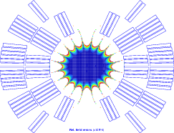
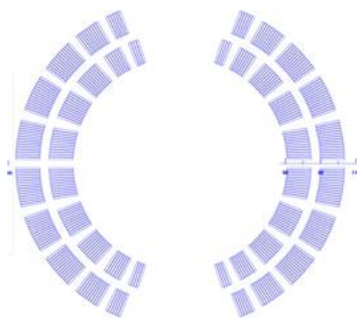
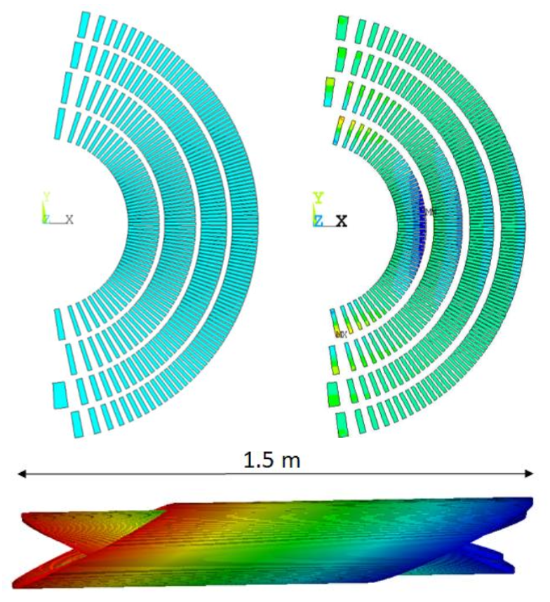
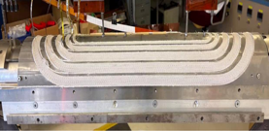
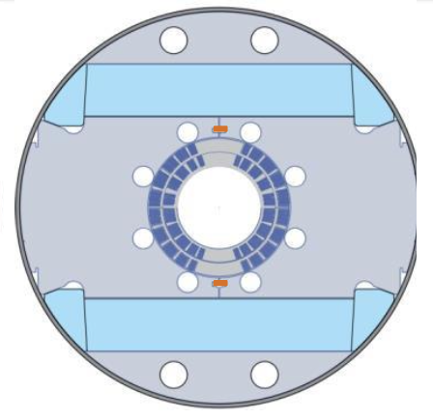
LTS degradation - stress-management with goal of >12T
Cosine Theta (NbTi):
  2 layers
    Bore field of ~8 T
    Bore diameter: 50-60mm
    Current workhorse for the colliders
Stress-managed Cosine Theta – large aperture (Nb₃Sn):
  2 layers
    Bore field of ~12 T
    Bore diameter: 120mm
Canted Cosine theta:
  4 layers
    Bore field of ~12 T / 13 T for standalone operation
    Bore diameter: 120 mm
SMCT
CCT
30+ % current margin at target fields of 12 T, 4.2 K and 13 T, 1.9 K
These are two variants on stress-management
CCT is a “limiting case” of maximal SM
SMCT is a more efficient design

Slide 11
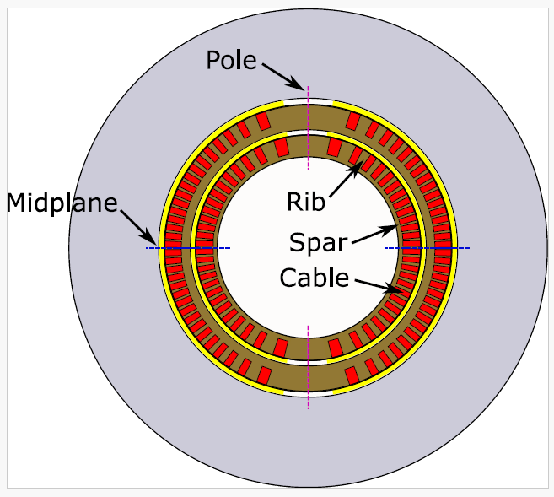
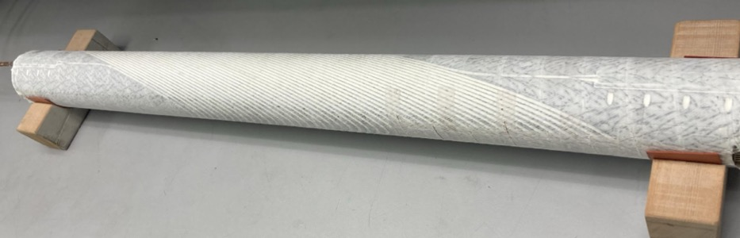
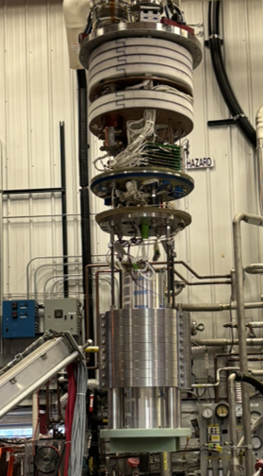
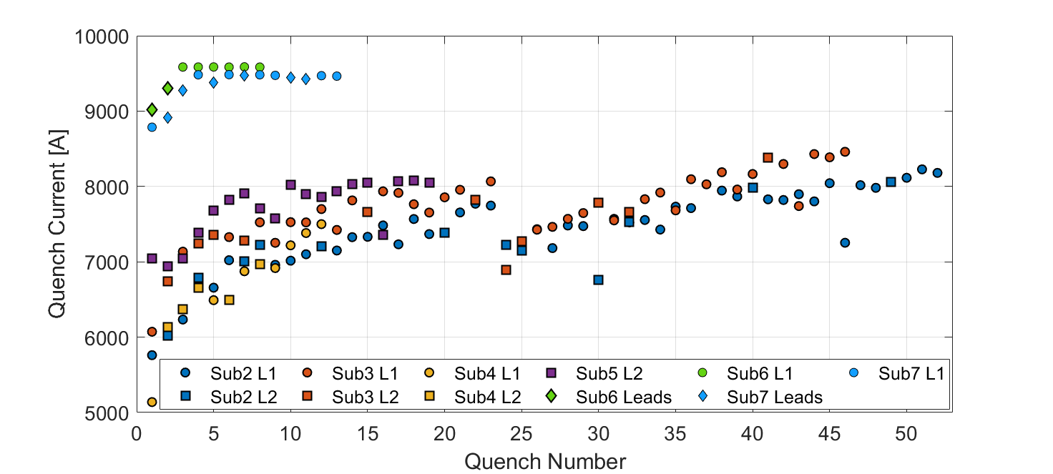
Magnets impregnated with Wax - Training Results
Subscale CCT’s built with Paraffin wax (sub-6), then filled-wax (sub-7)
Dramatic reduction in training, good memory - impacts collider magnet cost
No degradation observed - ready to scale to the 14-16T level
Quench Current
Max Field 11.1T
CCT5-W
9.9T
CCT5
Notes:
Deform,

Slide 12
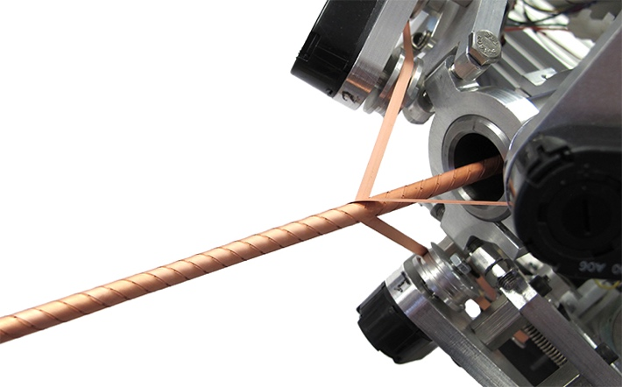
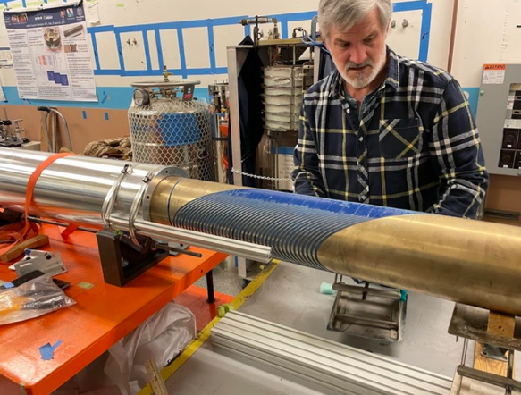
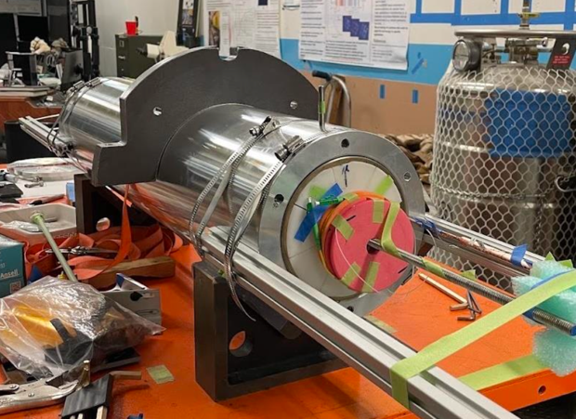
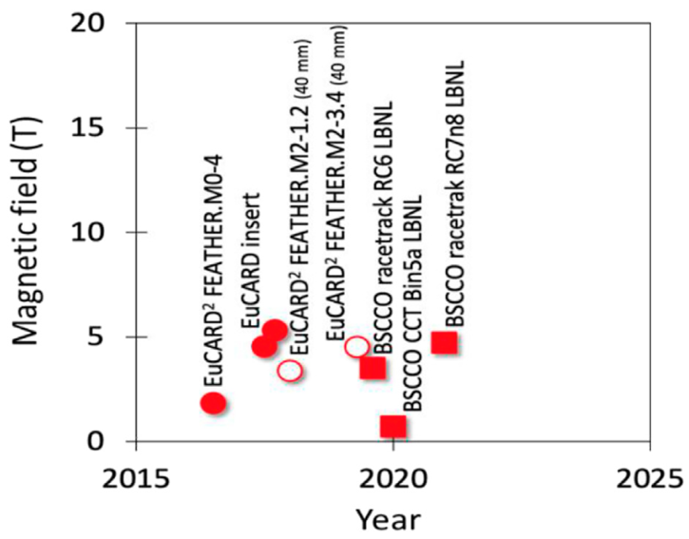
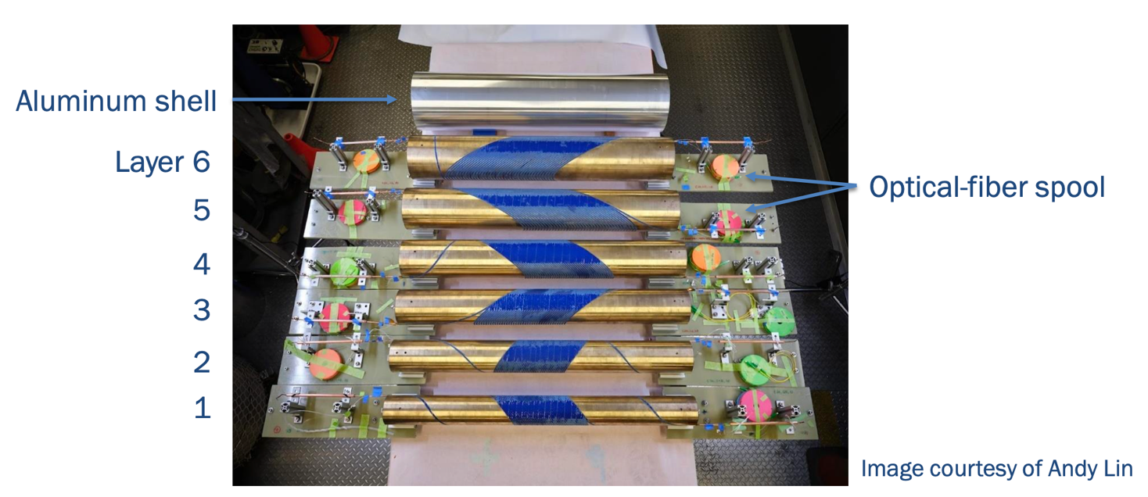
Major new result with REBCO HTS using CORC wire
145 m of CORC® (Conductor on Round Core) wires in six pieces, maximum piece length 35 m
Specified the minimum tape Ic for high-homogeniety tapes
Notes:
CORC - Conductor on Round Core

Slide 13
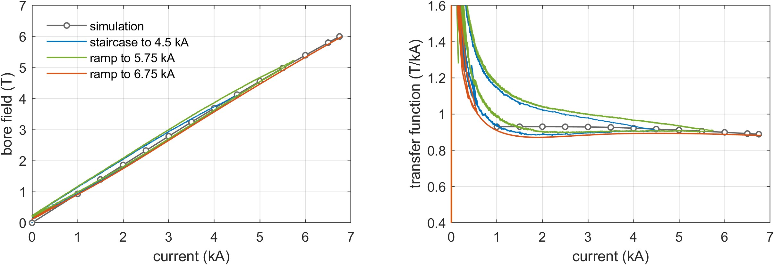
The dipole field reached record 5.99 T at 6.75 kA, in a 60mm bore
5.99 T
4.2 K
4.2 K
Peak I x B force on the conductor ~ 42 kN/m
Iron contribution ~ 1.1 T, 19% of the total field

Slide 14
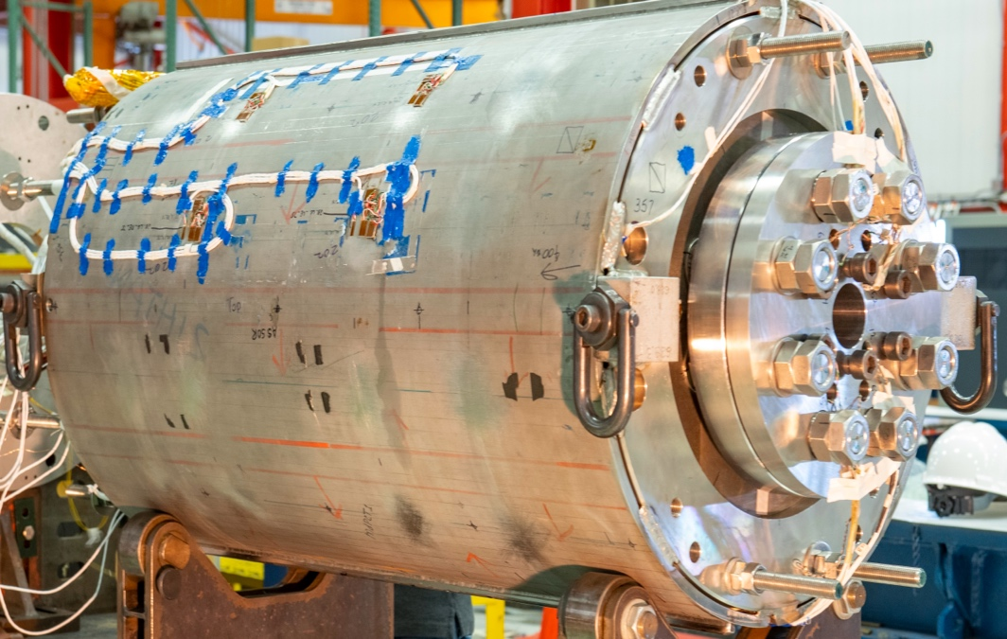
Summary #1
Future colliders depend critically on magnet technology
HEP in US invests in magnet technology through the US Magnet Development Program
US-MDP has an updated roadmap aligned with HEP strategic vision – Muon Collider
Recent progress has potential impact on collider performance and cost
US-MDP is increasingly focusing on advancing HTS accelerator magnet technology
Strong synergies are leveraged with fusion

Slide 15
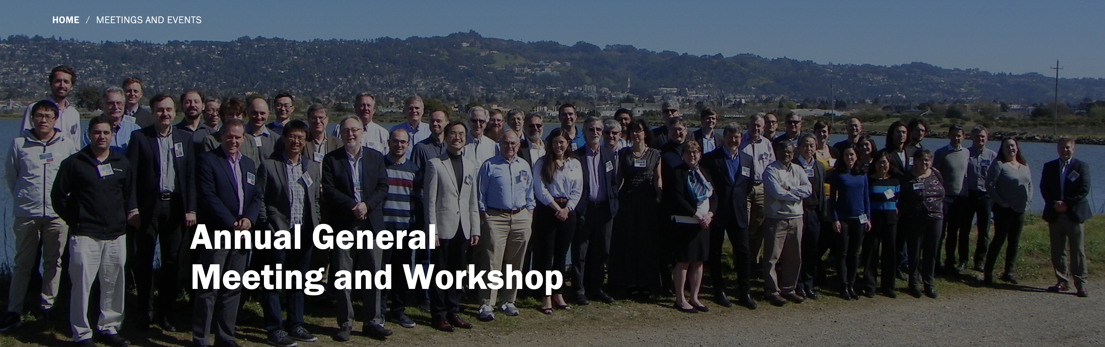
MDP Collaboration

Slide 16
Fermilab Test Facility for U.S. Fusion Programs
02

Slide 17
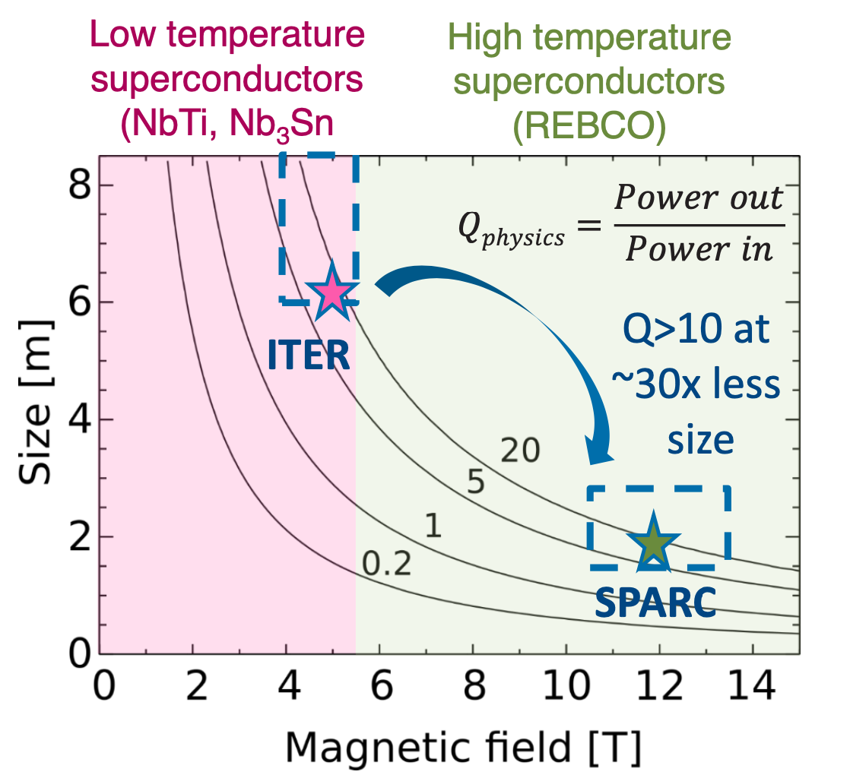
Introduction
High magnetic fields offer an attractive path to achieving net fusion energy.
The fusion community in the USA has been investigating the use of REBCO magnets, which could potentially facilitate the development of smaller Tokamak devices operating at higher fields.
Infrastructure for testing components for these magnets is currently under development.
Courtesy of Z. Hartwig (MIT/PSFC)
Notes:
MIT/Plasma Science and Fusion Center
CFS

Slide 18
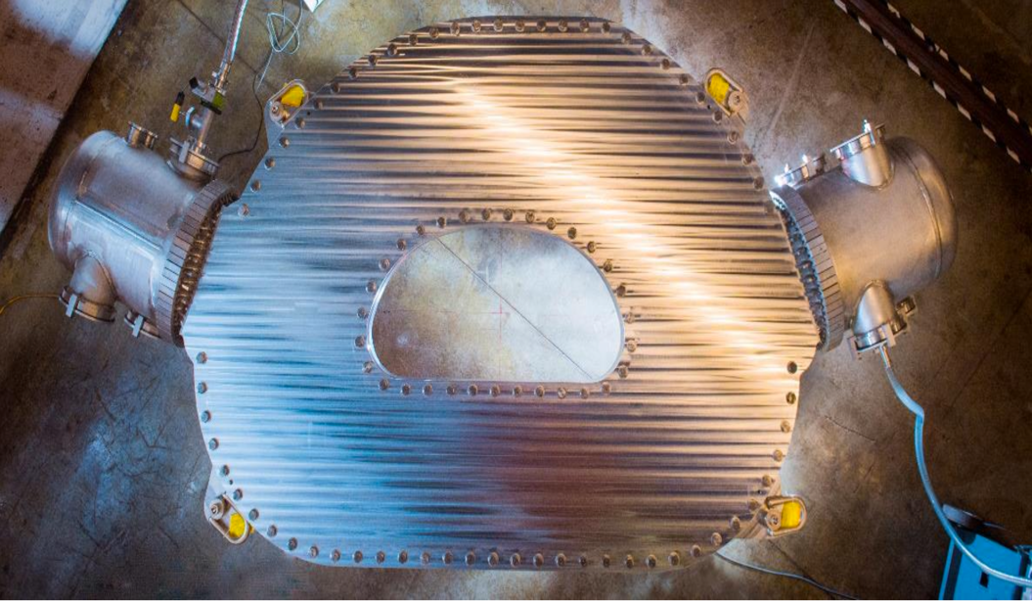
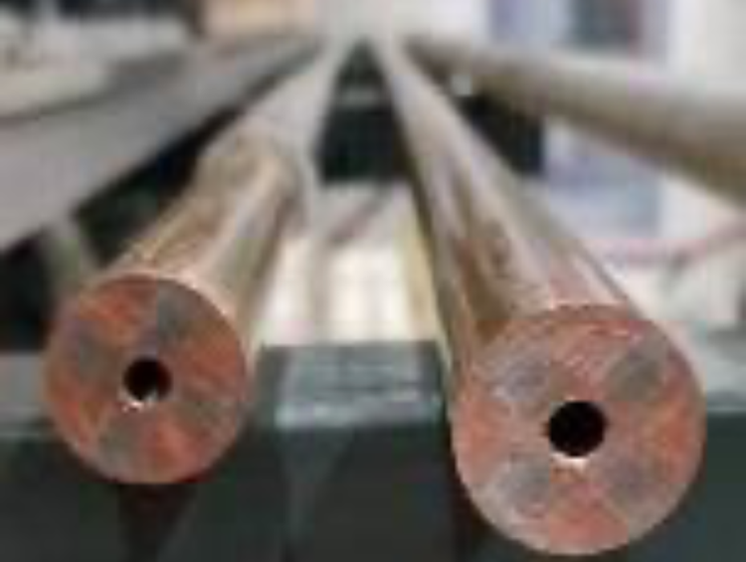
Challenges
MIT/Plasma Science and Fusion Center built a model toroidal coil for the first conceptual design machine (SPARC)
This device should produce the same power as ITER, in the volume, but significantly smaller than ITER
New CICCs was developed – e.g., VIPER
Challenges for US – to have in short time an operational test facility where cable optimizations and splice characterization can be performed
  at high currents ~ 100kA
  at variable temperatures
  at external fields up to 15 T
  quench characterization I_{c}
  efficient and user-friendly facility
TORIODAL COIL
2 m
VIPER CICC
Courtesy of Z. Hartwig (MIT/PSFC)

Slide 19
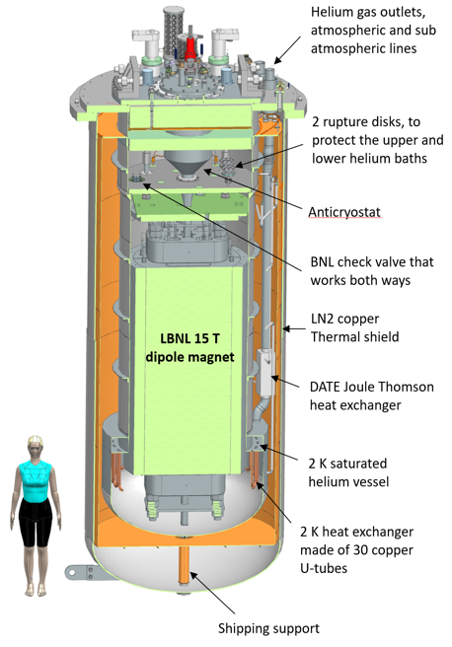
New test facility at Fermilab
US DOE Offices of High Energy Physics and Fusion Energy Sciences joined their effort to build HTS cable-testing facility.
This facility is currently constructed at Fermilab.
  For the US FES and HEP, it will serve as a test stand for HTS cables in high dipole field and at increased temperatures.
    It is designed to provide similar or better capabilities than SULTAN and EDIPO TF at PSI, and FRESCA2 at CERN
  For the US HEP Magnet Development Program, it will be the main facility for testing of magnets with 16-20 plus T fields, including hybrid magnets (LTS outer +HTS inner coils)

Slide 20
Test Facility – parameters
Fermilab was selected based on the needed infrastructure, including cryogenic, power, water and cranes
  Two liquefiers with capacity of ~ 640 liter/hour.
Minimum operating temperature of the facility is 1.9K for the magnet providing the background field and with min 4.5 K for the test samples, variable to ~50 K.
The test pit cryostat should accommodate a magnet with maximum dimensions of 1.3 m and length of ~3 m
The maximum energy stored in the test field dipole should be < 20 MJ
The maximum weight of the dipole cold mass should not exceed 20 ton
The test facility should be efficient and safe, minimizing the time for experiment preparation and no helium losses.
Operational lifetime of the facility at least 20 years.

Slide 21
Operational Modes
TWO OPERATIONAL MODES
Fusion mode - HTS cable test:
  In 15 T@1.9K ( ~15 kA)
  Anti-cryostat with sample holder for cable test, (CICC)
  Variable temperature for the cable 4.5 to 50 K
  SC transformer to provide 100kA
  Full diagnostic and protection
  Dedicated top and lambda plates
  Sample holder for HTS cables
Magnet R&D mode for MDP
  Large aperture/large diameter magnets LTS@1.9 K powered up to 24 kA
  Hybrid magnet tests (LTS + HTS) at 1.9 K powered with 16 kA PS
  Full diagnostic and protection
  Dedicated top and lambda plates

Slide 22
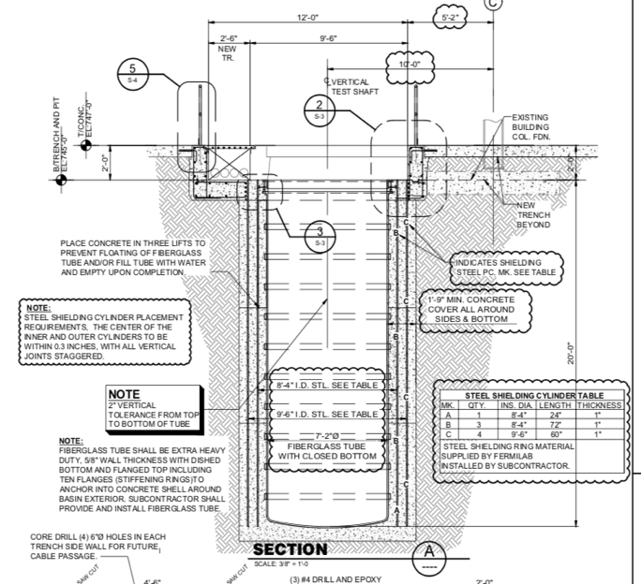
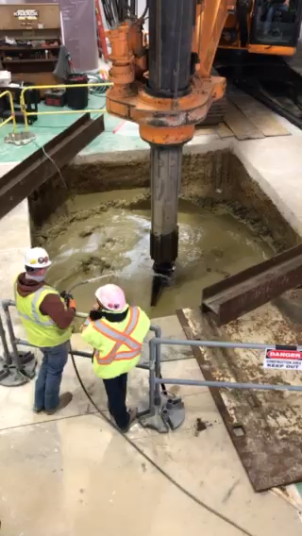
Pit Construction
Status
  Pit construction - finished in May 2021
We added two cylindrical steel shields to contain the fringe magnetic field.
Construction challenges:
  Heavy construction machines were used in the tight building space
  Preventing walls to collapse
Pit continues to be dry even during strong Midwest rains
9’-6’’ (2.9m)
20’ (6.1m)
Steel shields

Slide 23
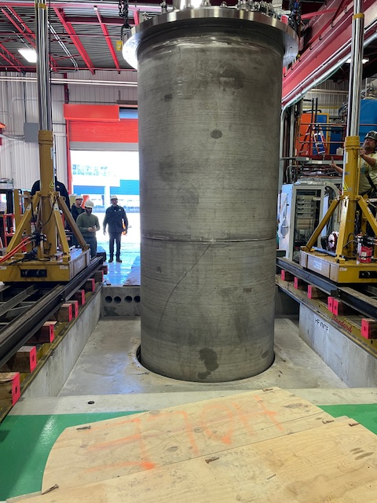

Cryostat
It is a large double-bath vessel with a lambda plate that separates the 4.5 K normal liquid helium on the upper section from the pressurized superfluid helium at 1.9 K and 1.3 bar
The current design of this helium vessel is similar to the existing test stands at Fermilab
Cryostat is delivered and installed.

Slide 24
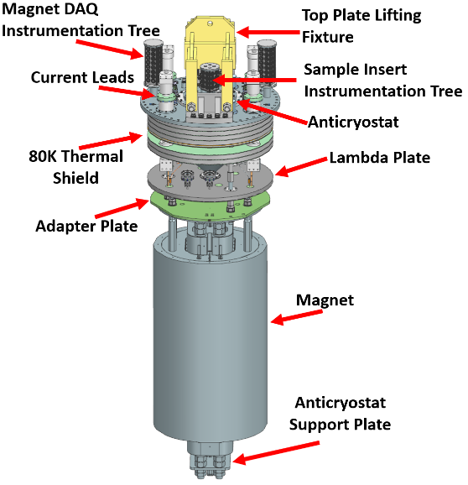
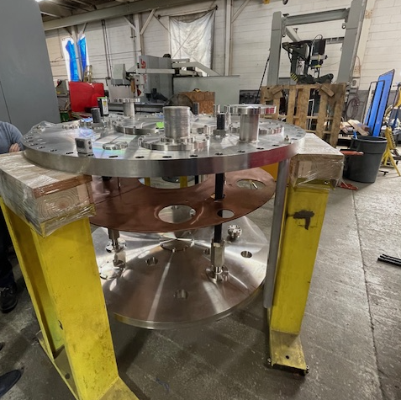
Top and lambda plates
Top (covering the cryostat) and lambda plates are near completion
The goal is to deliver them in April to start cold commissioning of the cryostat

Slide 25
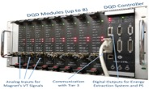
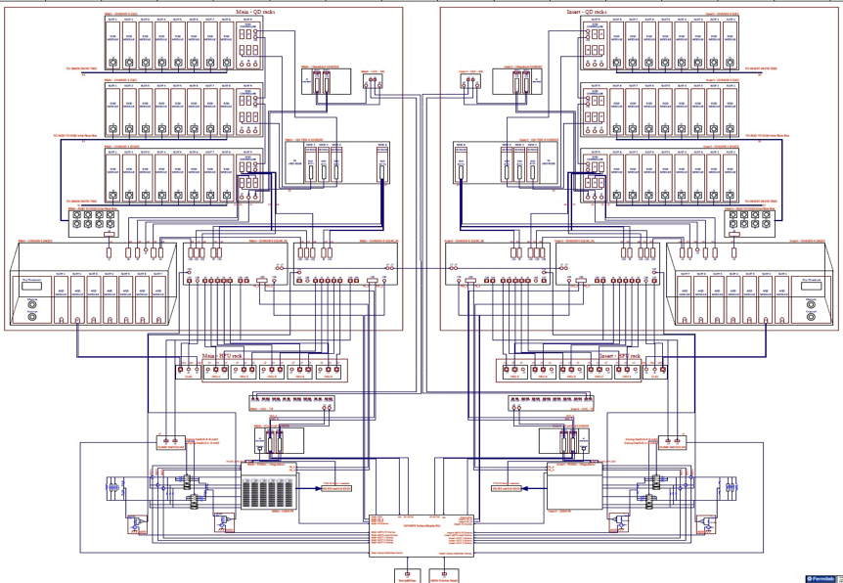

Quench Protection Architecture
Two branches protecting TF dipole and test sample
The facility is benefiting from the Lab projects (Mu2e) Production/Operational grade QP/QM.
Primary Custom Digital Quench Detection System (DQD).
Redundant Custom Analog Quench Detection (AQD).
Quench management system, based on commercial electronics.
It is 85% finalized. Some modifications are needed to include test capabilities for the samples.
DQD
Branch 1
Branch 2
AQD
Quench Detection & Management
Quench Logic &Protection
PS Control and Monitoring

Slide 26
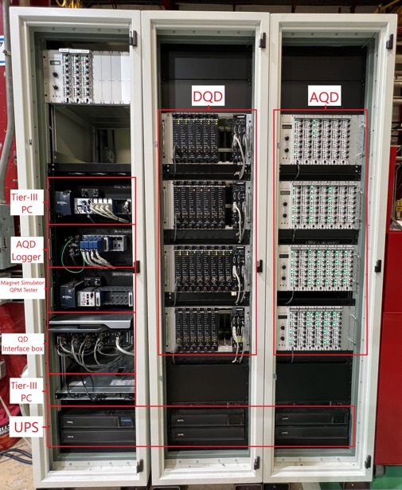
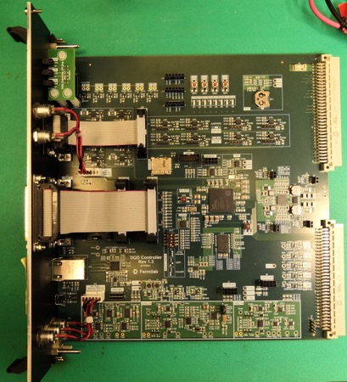
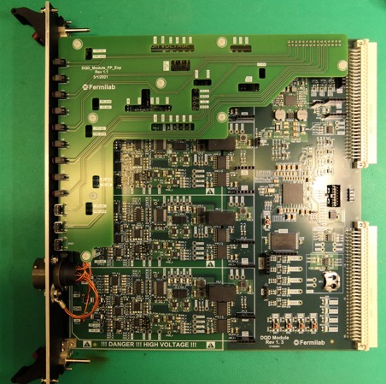
Quench Protection Cabinets and Boards

Slide 27
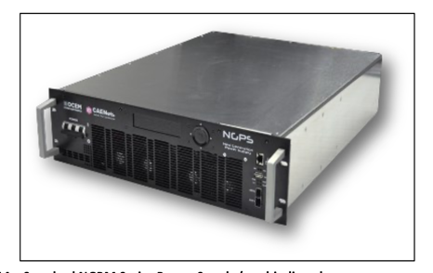

Power Supplies
24 kA PS system
We are procuring two sets of PSs:
  Min 20 V @24 kA to power the main magnet (LTS in case of hybrid magnet tests)
  Min 20 V @16 kA to power the sample (SC transformer or HTS inset of hybrid magnet tests).
We built modular systems on switch-mode power supply modules, interchangeable
Deliver is expected in May 2026

Slide 28



Magnet Specification
Field: 16 T design target with >15% margin on the load line at 1.9 K
  15 T is used as reference for operation
Magnet design is based on past development and studies of block-coil dipoles (HD, FRESCA2 and HEPdipo) - Rutherford cable for the coils with shell-based structure with axial pre-load
Quench Protection: energy extraction (resistor dump) is sufficient for safe magnet discharge
Uniform field length: 750 mm within 1% variation at 30 mm radius
Coil 2
R_{min}:
54 mm
Layer 4: 44 turns
Layer 3: 44 turns
Layer 2: 40 turns
Layer 1: 40 turns
Coil 1
Shell OD | m | 1.3
Shell length | m | 2.0
Total length | m | 2.9
D. Arbelaez, P. Ferracin, R. Hafalia, P. Mallon, D. Martins Araujo, J. L. Rudeiros Fernandez, G. Vallone et al.

Slide 29





Anti-cryostat and sample holder
We have a preliminary design of the anti-cryostat
Expected operational mode: field is perpendicular to the test sample
Clear aperture: (EDIPO) 144 mm (H) x 94 mm (V)
Superimposed with 106 mm round for compatibility with FRESCA2
B=15 T
F=1.5MN/m
EDIPO/Sultan configuration
I_{max}=100 kA

Slide 30
Summary #2
The USA fusion community has been exploring the use of high-temperature superconducting (HTS) magnets for smaller Tokamak devices
The existing test facility will provide testing capabilities for SC cables, similar or better to EDIPO and SULTAN
US DOE Offices of High Energy Physics and Fusion Energy Sciences joined their effort to build HTS cable-testing facility at Fermilab:
  The test pit construction is done
  Cryostat is installed.
  The QP system is a close copy of Fermilab’s mu2e experiment production systems
  Power supplies are expected in May.
  The anticrystal/sample holder is in preliminary design
  The current estimation of the stand completion of TF is the fall 2028, with TF magnet - 2029.
  Having experience in the SC magnets and cryo technologies, Fermilab LBNL are fully committed to support in the US fusion community with a near-term goal to build and operate a SC cable testing facility

Slide 31

Thank you!

Slide 32
Backup slides

Slide 33





Nb-Ti
(round wire):
Nb₃Sn (round wire):
A Nb-Ti wire is composed of thousands of Nb-Ti filaments embedded in the Cu matrix.
Nb₃Sn has four major production routes (i.e., four types of wires): bronze-process, single-barrier internal-tin, restack-rod-process (RRP), and powder-in-tube (PIT). Here the schematic for the RRP type is shown.
(a)-(c): production of a subelement. (d): Stacking of subelements into a Cu can to form an RRP billet. There are typically 50-200 Nb₃Sn subelements embedded in the Cu matrix.
Bi-2212 (round wire):
ReBCO (tape):
A Bi-2212 wire is composed of hundreds to thousands of Bi-2212 filaments (made from Bi-2212 powder) embedded in the silver matrix.
Note: the outer sheath tube can sometimes be made of Ag-0.2wt.%Mg alloy instead of pure Ag, in order to improve wire strength.
Thicknesses of the layers (which can vary):
buffer
G. Velev | 80th Anniversary of the Department of Atomic Physics at Sofia University

Slide 34








Coil fabrication and instrumentation
Coil winding and curing using ceramic binder
Coil reaction
Coil lead splicing and epoxy impregnation
Coil size control, accuracy ~10 microns
Coil instrumentation
Coil fabrication - approximately 3 months

Slide 35






Coil assembly, yoking and skinning

Slide 36





Filled Wax Impregnation Beyond Subscale Models (CCT5W)
CCT5w cable parameters
✔️
✔️
✔️

Slide 37

SPARC TFMC (MIT)
Courtesy of Z. Hartwig (MIT/PSFC)
Facility built to test a Toroidal Field Model
Suitable for testing large-scale coils
No background magnetic field
Formally does not operate it as a "user
facility" - would be open if there are users out there who see a need.
Some key parameters might be:
  Coils <3m in x-y scale, <0.5m in z-scale
  Temperatures between 20-40 K
  Currents up to 50 kA (at voltages < 100 V)
  Full set of diagnostics capabilities: V-taps, heaters, Cernoxes, flow meters, strain gauges, etc.
Cannot be used directly to test SC cables
50 kA feeder system
The Toroidal Field Magnet Coil
https://indico.cern.ch/event/1165664/attachments/2487093/4273745/CERN_TFMC_Hartwig_20220727.pdf
Notes:
Toroidal Field Magnet Coil

Slide 38


NHMFL: HTS Test-bed
14 T HTS Coil Test Bed
Solenoidal field
Magnet bore 161 mm, 200 mm access bore for leads, 128 ppm homogeneity
Large bore enables insert magnets:
To explore field generation and mechanical limits cables and coils
Implement novel HTS quench management
Upgrades underway: 2 more 1.2 kA supplies, 10 kA, FPGA control, and faster IGBT replacement to mechanical contactors for quench management
Cannot be used for test of the large diameter CICC
Courtesy of D. Davis (NHMFL)
G. Velev | 4th Superconducting Magnet Test Facility Workshop
38

Slide 39





Nb₃Sn Common Coil Dipole for High Current HTS Cable Testing - BNL
A Nb₃Sn dipole with a large opening (335 mm x 31 mm) providing a field of 10.2 T
Unique Features: High current, long length, HTS cables with large bend radius can be tested in applied dipole field (important for Fusion cables)
HTS cables can be tested at high temperatures (4K – 50⁺ K) with small upgrades
Advanced instrumentation (quench protection)
Innovative R&D facility offers unique opportunities to fusion
Empty space
https://www.bnl.gov/magnets/staff/gupta/commoncoil/cc-bnl-rapid-rnd-testing.pdf

Slide 40


TFD aperture

