Slide 1

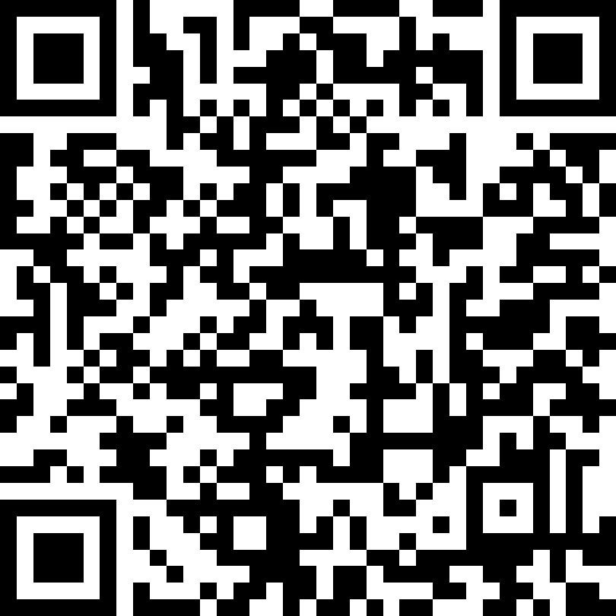


INSTITUTE FOR NUCLEAR RESEARCH AND NUCLEAR ENERGY
BULGARIAN ACADEMY OF SCIENCES
Discussion about a new possible experiment for detection of resonance Mössbauer electron neutrinos
V. Rusanov
B. Bonchev
V. Kozhuharov
D. Tonev
Rusanov, V., Bonchev, B., Kozhuharov, V., & Tonev, D. (2024). Discussion about a new possible experiment for detection of resonance Mössbauer electron neutrinos. Nuclear Instruments and Methods in Physics Research Section A: Accelerators, Spectrometers, Detectors and Associated Equipment, 1065, 169566. https://doi.org/10.1016/J.NIMA.2024.169566
София
2026

Slide 2
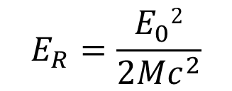

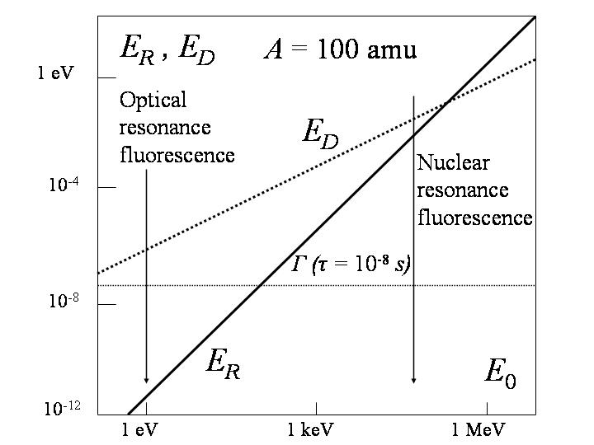
Dependence of the recoil energy and Doppler broadening on the gamma-quantum energy.
T = 300 K, A = 100 amu. The natural linewidth Γ corresponds to an excited state lifetime of τ = 10⁻⁸ s.

Slide 3
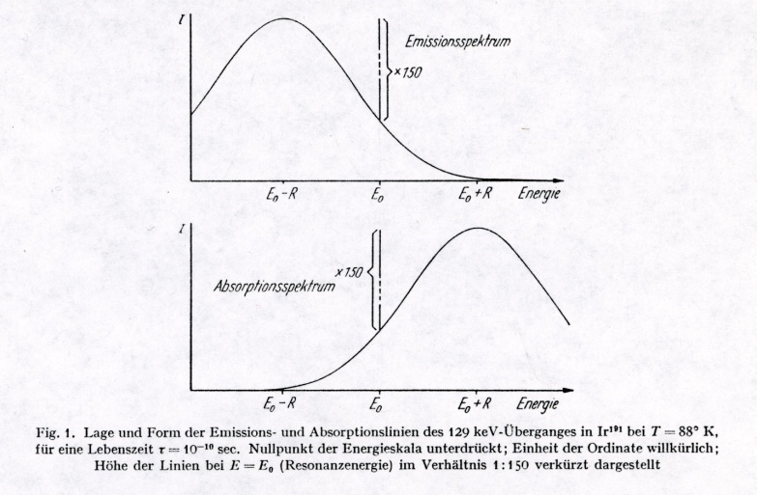
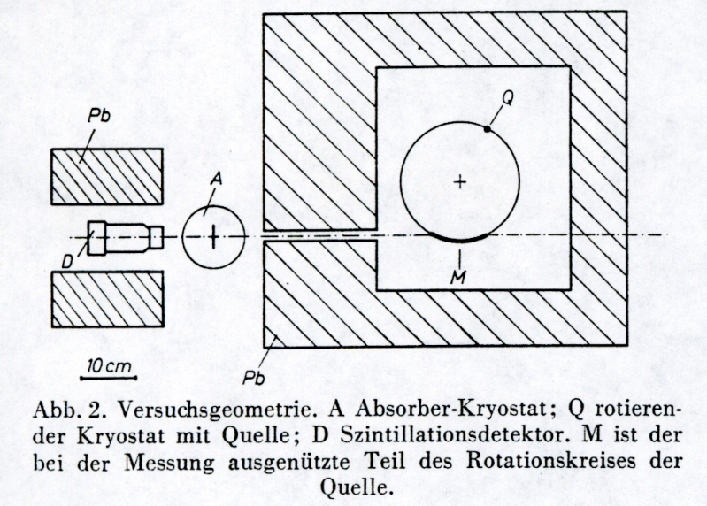
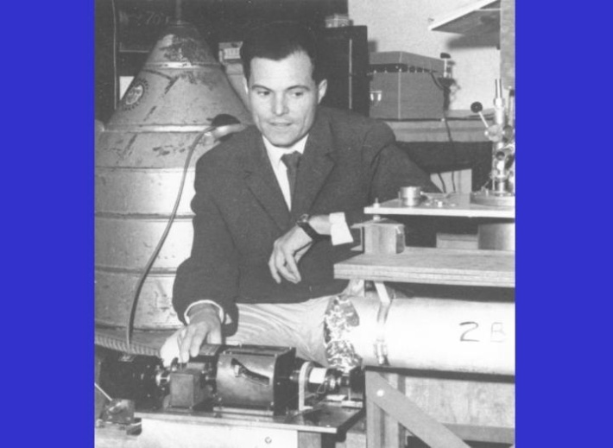
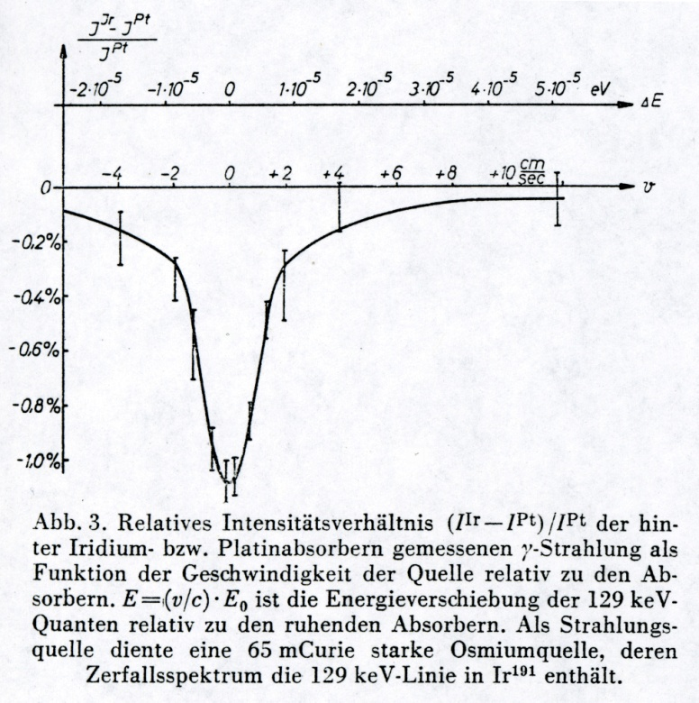
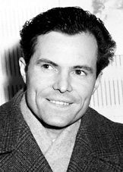
INSTITUTE FOR NUCLEAR RESEARCH AND NUCLEAR ENERGY
BULGARIAN ACADEMY OF SCIENCES
R. Mössbauer photo from 1958
Rudolf Ludwig Mössbauer
(*31.01.1929 - †14.09.2011) The
photograph was likely taken shortly before or after he received the Nobel Prize in Physics. The award ceremony and the Nobel lecture took place on December 11, 1961.
1. R. Mössbauer, Z. Phys. 151, 124 (1958).
2. R. Mössbauer, Naturwissenschaften 45, 538 (1958).
3. R. Mössbauer, Z. Naturforsch. A 14, 211 (1959).

Slide 4
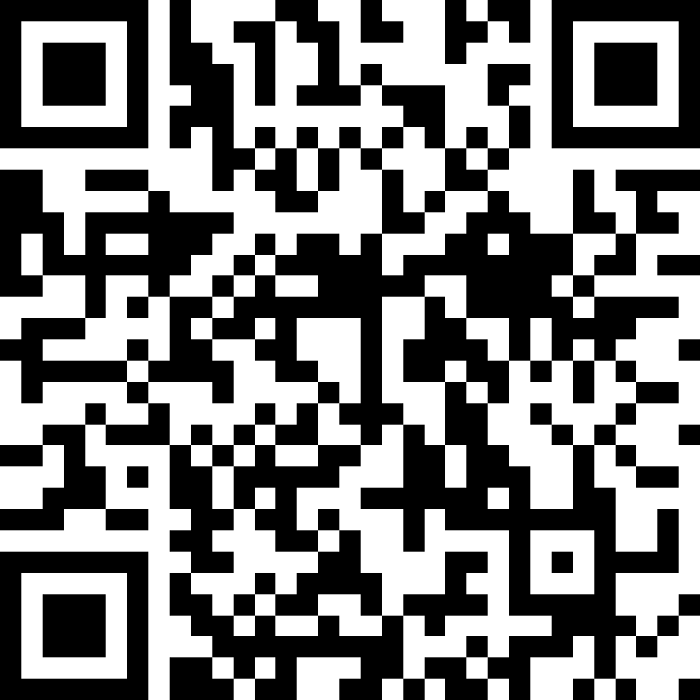
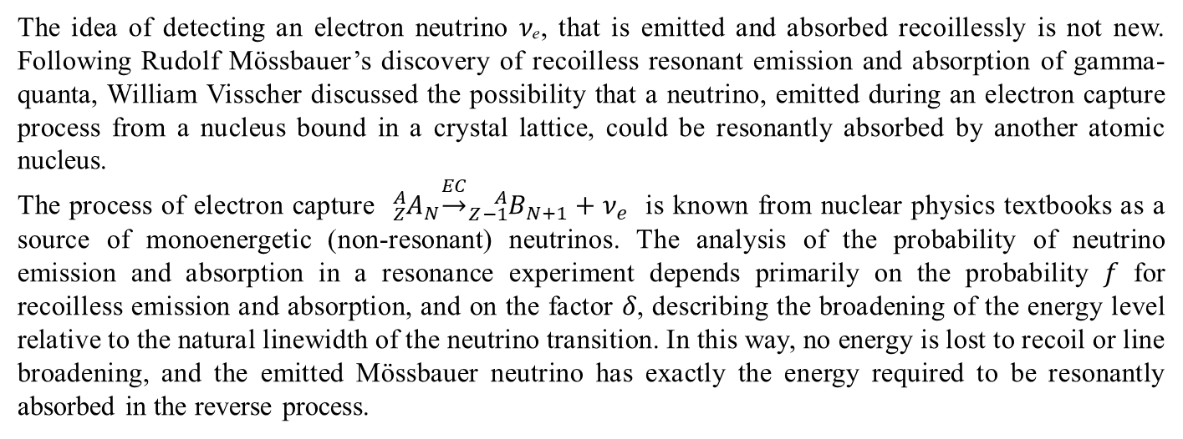
INSTITUTE FOR NUCLEAR RESEARCH AND NUCLEAR ENERGY
BULGARIAN ACADEMY OF SCIENCES
The idea of detecting an electron neutrino 𝜈ₑ, that is emitted and absorbed recoillessly is not new. Following Rudolf Mössbauer’s discovery of recoilless resonant emission and absorption of gamma- quanta, William Visscher discussed the possibility that a neutrino, emitted during an electron capture process from a nucleus bound in a crystal lattice, could be resonantly absorbed by another atomic nucleus.
The process of electron capture ${}_{Z}^{A}{A_{N}}\underset{→}{EC}{}_{Z−1}^{A}{B_{N+1}}+ν_{e}$ is known from nuclear physics textbooks as a source of monoenergetic (non-resonant) neutrinos. The analysis of the probability of neutrino emission and absorption in a resonance experiment depends primarily on the probability 𝑓 for recoilless emission and absorption, and on the factor 𝛿, describing the broadening of the energy level relative to the natural linewidth of the neutrino transition. In this way, no energy is lost to recoil or line broadening, and the emitted Mössbauer neutrino has exactly the energy required to be resonantly absorbed in the reverse process.
Neutrino Detection by Resonance Absorption in Crystals at Low Temperatures
Visscher W. M. Physical Review. 1959 Dec 15;116(6):1581. doi:10.1103/PhysRev.116.1581

Slide 5
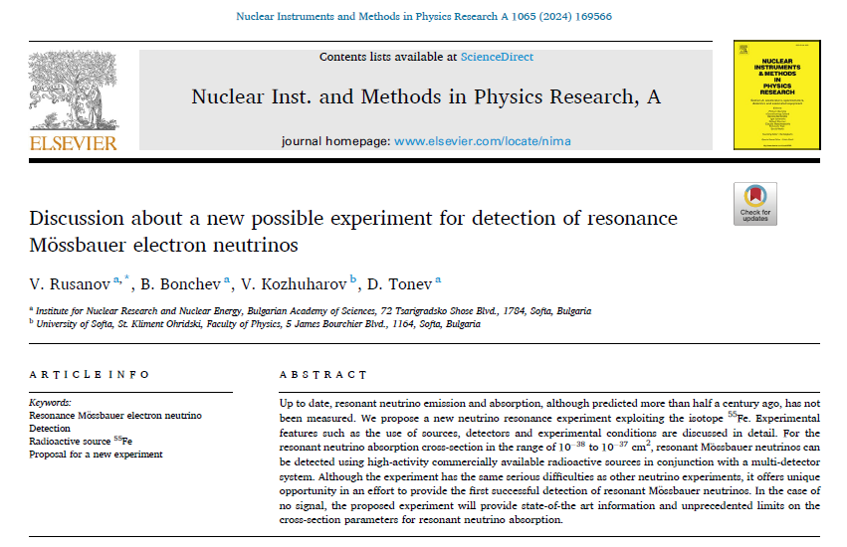
INSTITUTE FOR NUCLEAR RESEARCH AND NUCLEAR ENERGY
BULGARIAN ACADEMY OF SCIENCES

Slide 6
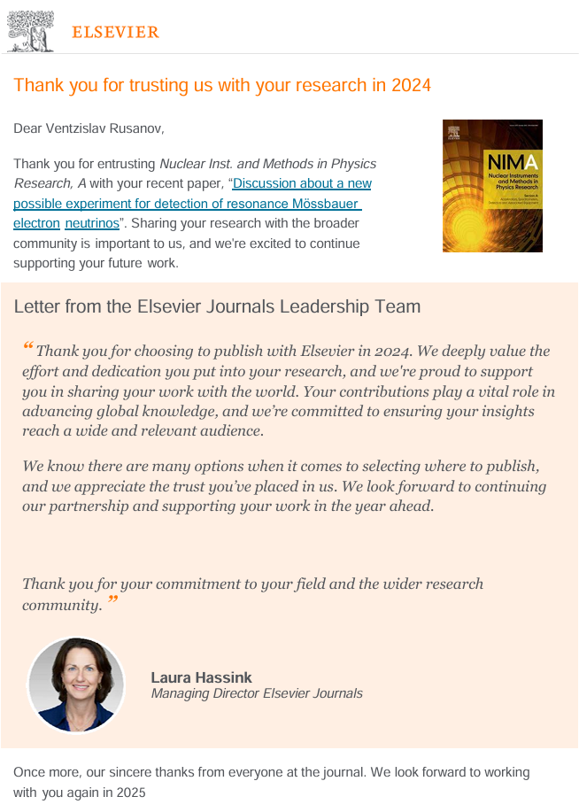

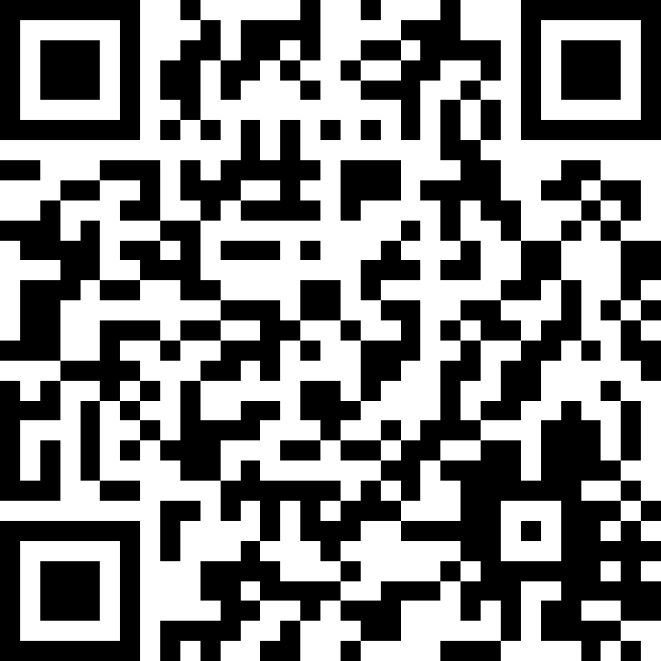
INSTITUTE FOR NUCLEAR RESEARCH AND NUCLEAR ENERGY
BULGARIAN ACADEMY OF SCIENCES

Slide 7
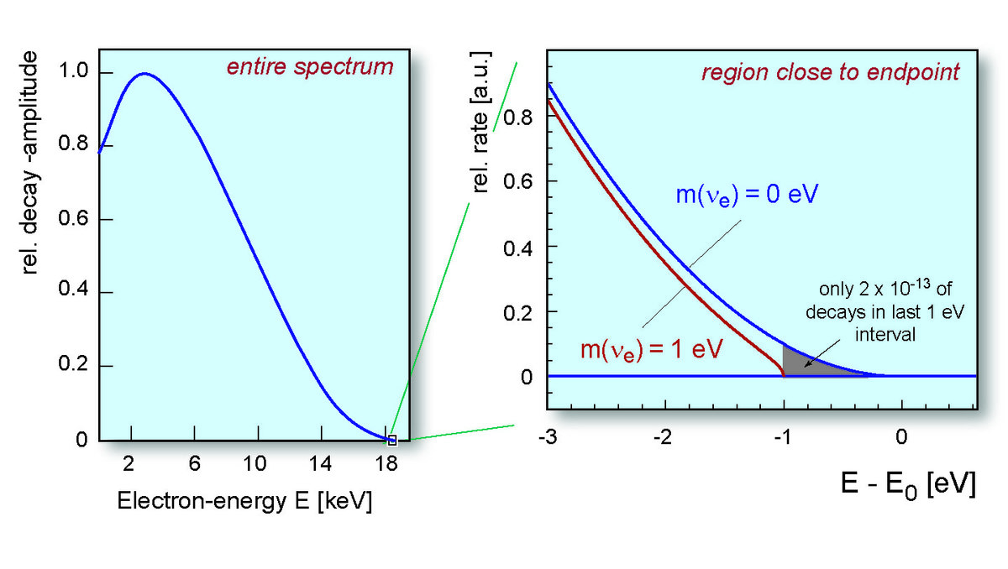

INSTITUTE FOR NUCLEAR RESEARCH AND NUCLEAR ENERGY
BULGARIAN ACADEMY OF SCIENCES
Continuous beta-decay
$${{}_{1}^{3}H}_{2}\underset{→}{{CB(β}^{−})}{{}_{2}^{3}{He}}_{1}+e^{−}+{\overline{ν}}_{e}$$
Electron spectrum from tritium beta-decay.
General shape (left) and magnified view of the region near the endpoint energy of the spectrum. The blue and red curves represent the expected spectra for the case of a massless neutrino and a neutrino with a mass of 1 eV, respectively – a value much larger than the currently expected one.
Illustrations: katrin.kit.edu

Slide 8
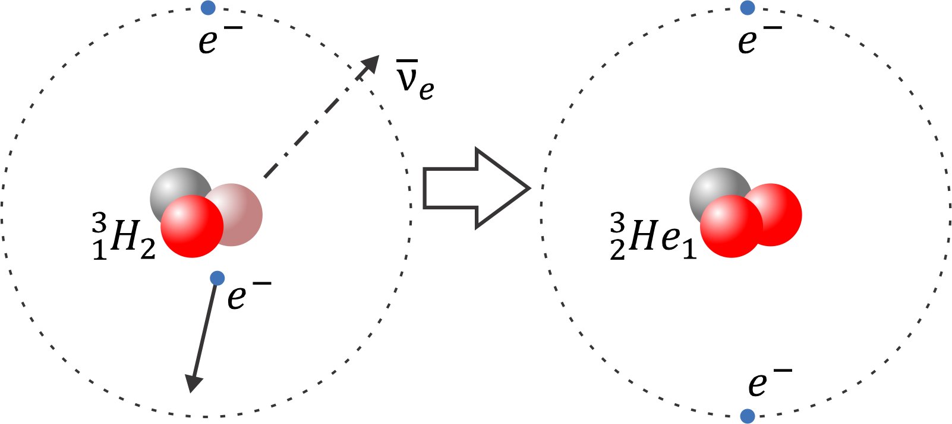
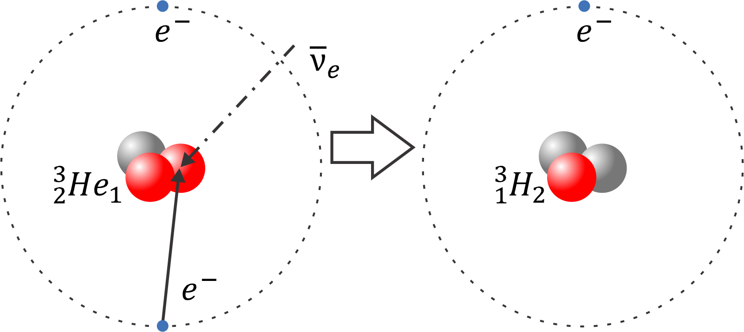


INSTITUTE FOR NUCLEAR RESEARCH AND NUCLEAR ENERGY
BULGARIAN ACADEMY OF SCIENCES
Bound-beta and inverse bound-beta decay
$${{}_{1}^{3}H}_{2}\underset{→}{{BB(β}^{−})}{{}_{2}^{3}{He}}_{1}+{\overline{ν}}_{e}$$
$${{}_{2}^{3}{He}}_{1}+{\overline{ν}}_{e}+e^{−}\underset{→}{{IBB(β}^{−})}{{}_{1}^{3}H}_{2}$$
Inverse bound-beta decay
(antineutrino induced electron capture)
Bound-beta decay
The tritium and helium atoms are adsorbed in porous Nb metal at helium temperature.

Slide 9
INSTITUTE FOR NUCLEAR RESEARCH AND NUCLEAR ENERGY
BULGARIAN ACADEMY OF SCIENCES
A detailed discussion can be found in:
Potzel W., & Wagner F. E. (2012). Mössbauer Effect with Electron Antineutrinos. In Kalvius Michael & Kienle Paul (Eds.), The Rudolf Mössbauer Story: His Scientific Work and Its Impact on Science and History (pp. 373–389). Springer Berlin Heidelberg : Imprint: Springer.

Slide 10
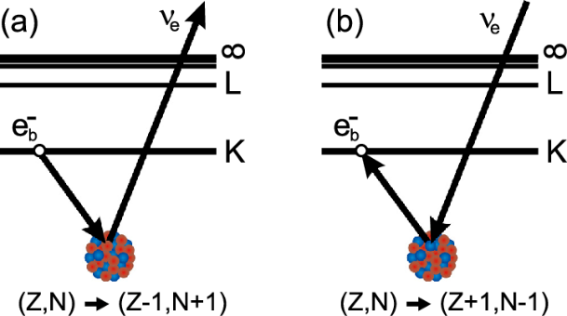

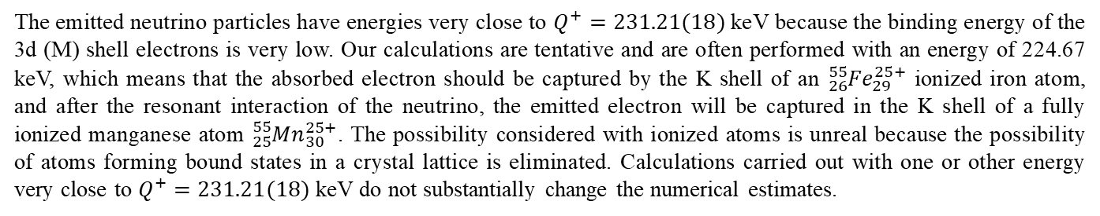

INSTITUTE FOR NUCLEAR RESEARCH AND NUCLEAR ENERGY
BULGARIAN ACADEMY OF SCIENCES
Electron capture and bound-electron capture
M
M
$${{}_{26}^{55}{Fe}}_{29}\underset{→}{EC}{{}_{25}^{55}{Mn}}_{30}+ν_{e}$$
$${{}_{25}^{55}{Mn}}_{30}+ν_{e}\underset{→}{BEC}{{}_{26}^{55}{Fe}}_{29}$$
Schematic presentation of (a) electronic capture and (b) bonded electronic capture
The emitted neutrino particles have energies very close to $Q^{+}=231.21(18)$ keV because the binding energy of the 3d (M) shell electrons is very low. Our calculations are tentative and are often performed with an energy of 224.67 keV, which means that the absorbed electron should be captured by the K shell of an ${{}_{26}^{55}{Fe}}_{29}^{25+}$ ionized iron atom, and after the resonant interaction of the neutrino, the emitted electron will be captured in the K shell of a fully ionized manganese atom ${{}_{25}^{55}{Mn}}_{30}^{25+}$. The possibility considered with ionized atoms is unreal because the possibility of atoms forming bound states in a crystal lattice is eliminated. Calculations carried out with one or other energy very close to $Q^{+}=231.21(18)$ keV do not substantially change the numerical estimates.

Slide 11
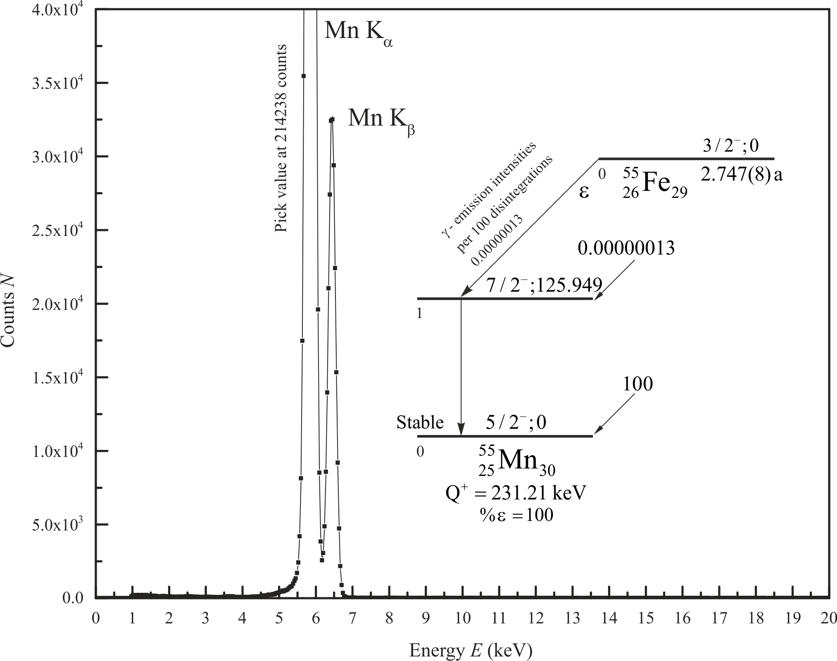
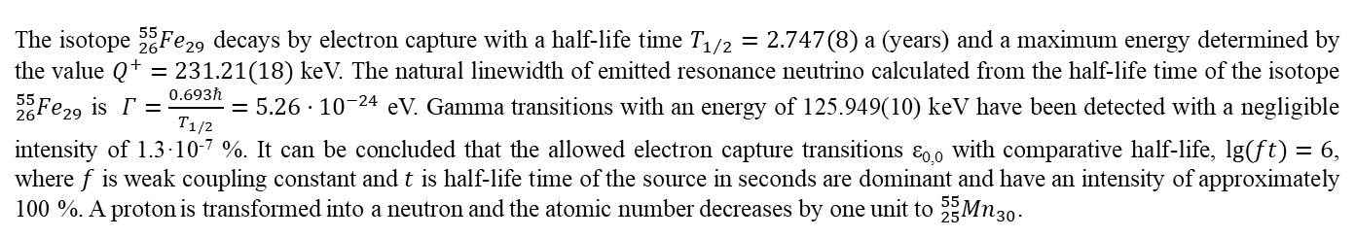
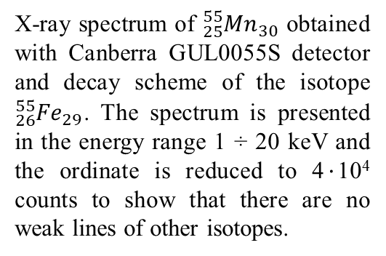
INSTITUTE FOR NUCLEAR RESEARCH AND NUCLEAR ENERGY
BULGARIAN ACADEMY OF SCIENCES
X-ray spectrum of ${{}_{25}^{55}{Mn}}_{30}$ obtained with Canberra GUL0055S detector and decay scheme of the isotope ${{}_{26}^{55}{Fe}}_{29}$. The spectrum is presented in the energy range 1 ÷ 20 keV and the ordinate is reduced to 4$·$10⁴ counts to show that there are no weak lines of other isotopes.
The isotope ${{}_{26}^{55}{Fe}}_{29}$ decays by electron capture with a half-life time $T_{1/2}=2.747\left(8\right)$ a (years) and a maximum energy determined by the value $Q^{+}=231.21(18)$ keV. The natural linewidth of emitted resonance neutrino calculated from the half-life time of the isotope ${{}_{26}^{55}{Fe}}_{29}$ is $Γ=\frac{0.693ℏ}{T_{1/2}}=5.26·{10}^{−24}$ eV. Gamma transitions with an energy of 125.949(10) keV have been detected with a negligible intensity of 1.3·10⁻⁷ %. It can be concluded that the allowed electron capture transitions ε_{0,0} with comparative half-life, $\lg{(ft)=6}$, where $f$ is weak coupling constant and $t$ is half-life time of the source in seconds are dominant and have an intensity of approximately 100 %. A proton is transformed into a neutron and the atomic number decreases by one unit to ${{}_{25}^{55}{Mn}}_{30}$.

Slide 12
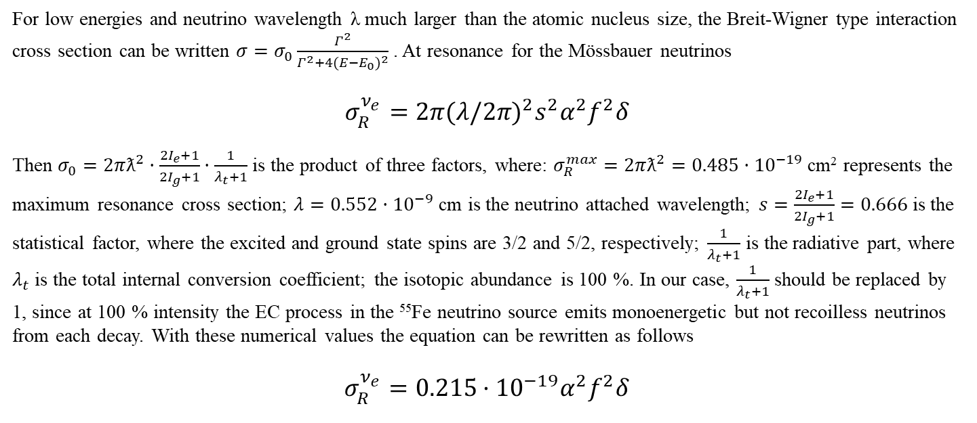
INSTITUTE FOR NUCLEAR RESEARCH AND NUCLEAR ENERGY
BULGARIAN ACADEMY OF SCIENCES
The resonance cross section
For low energies and neutrino wavelength λ much larger than the atomic nucleus size, the Breit-Wigner type interaction cross section can be written $σ=σ_{0}\frac{Γ^{2}}{Γ^{2}+{4(E−E_{0})}^{2}}$ . At resonance for the Mössbauer neutrinos
$$σ_{R}^{ν_{e}}=2π{(λ/2π)}^{2}s^{2}α^{2}f^{2}δ$$
Then $σ_{0}=2πƛ^{2}·\frac{2I_{e}+1}{2I_{g}+1}·\frac{1}{λ_{t}+1}$ is the product of three factors, where: $σ_{R}^{max}=2πƛ^{2}=0.485·{10}^{−19}$cm² represents the maximum resonance cross section; $λ=0.552·{10}^{−9}$ cm is the neutrino attached wavelength; $s=\frac{2I_{e}+1}{2I_{g}+1}=0.666$is the statistical factor, where the excited and ground state spins are 3/2 and 5/2, respectively; $\frac{1}{λ_{t}+1}$ is the radiative part, where $λ_{t}$ is the total internal conversion coefficient; the isotopic abundance is 100 %. In our case, $\frac{1}{λ_{t}+1}$ should be replaced by 1, since at 100 % intensity the EC process in the ⁵⁵Fe neutrino source emits monoenergetic but not recoilless neutrinos from each decay. With these numerical values the equation can be rewritten as follows
$$σ_{R}^{ν_{e}}=0.215·{10}^{−19}α^{2}f^{2}δ$$

Slide 13

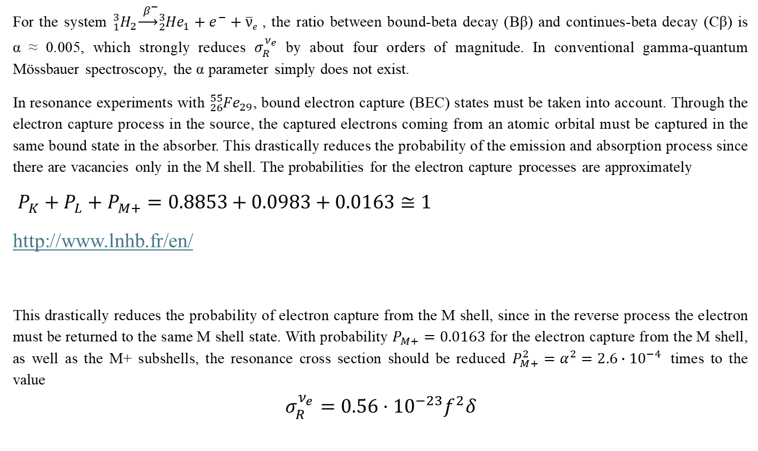
INSTITUTE FOR NUCLEAR RESEARCH AND NUCLEAR ENERGY
BULGARIAN ACADEMY OF SCIENCES
For the system ${}_{1}^{3}{H_{2}}\underset{→}{{ β}^{−}}{}_{2}^{3}{{He}_{1}}+e^{−}+\overline{ν}$_{e} , the ratio between bound-beta decay (Bβ) and continues-beta decay (Cβ) is
α ≈ 0.005, which strongly reduces $σ_{R}^{ν_{e}}$ by about four orders of magnitude. In conventional gamma-quantum Mössbauer spectroscopy, the α parameter simply does not exist.
In resonance experiments with ${{}_{26}^{55}{Fe}}_{29}$, bound electron capture (BEC) states must be taken into account. Through the electron capture process in the source, the captured electrons coming from an atomic orbital must be captured in the same bound state in the absorber. This drastically reduces the probability of the emission and absorption process since there are vacancies only in the M shell. The probabilities for the electron capture processes are approximately
$P_{K}+P_{L}+P_{M+}=0.8853+0.0983+0.0163≅1$
http://www.lnhb.fr/en/
This drastically reduces the probability of electron capture from the M shell, since in the reverse process the electron must be returned to the same M shell state. With probability $P_{M+}=0.0163$ for the electron capture from the M shell, as well as the M+ subshells, the resonance cross section should be reduced ${P_{M+}^{2}=α}^{2}=2.6∙{10}^{−4}$ times to the value
$$σ_{R}^{ν_{e}}=0.56·{10}^{−23}f^{2}δ$$

Slide 14
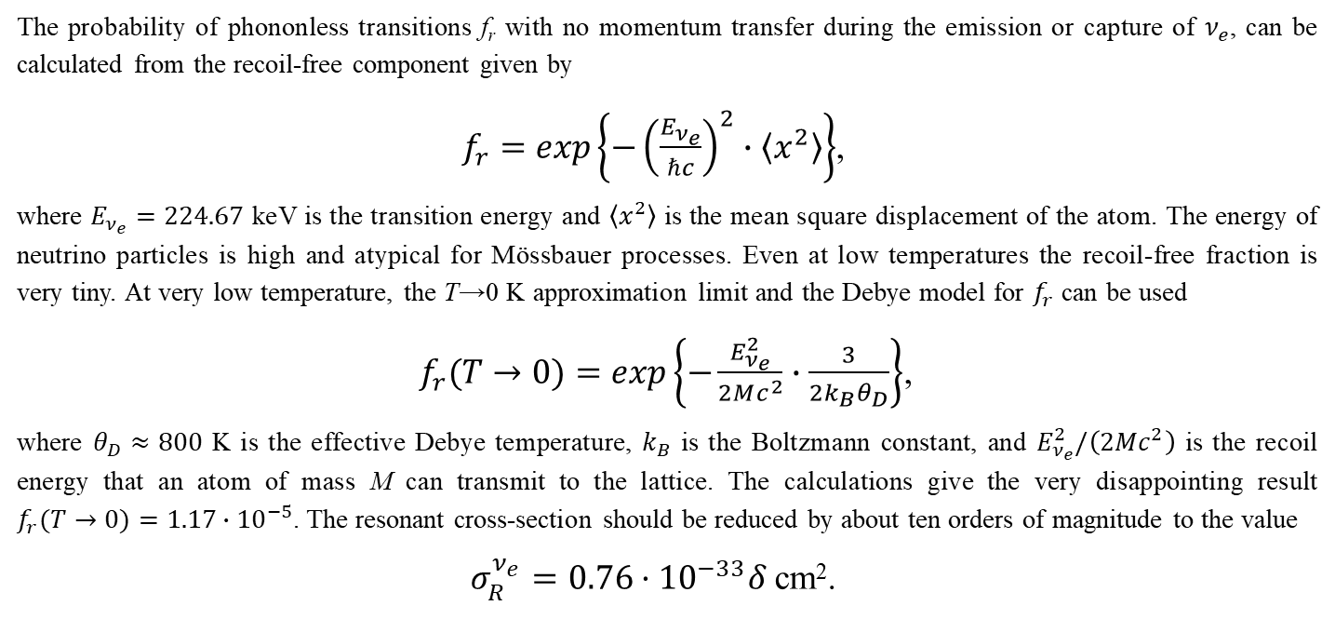
INSTITUTE FOR NUCLEAR RESEARCH AND NUCLEAR ENERGY
BULGARIAN ACADEMY OF SCIENCES
The resonance cross-section without momentum transfer for bound electron capture (BEC) state
The probability of phononless transitions f_{r} with no momentum transfer during the emission or capture of $ν_{e}$, can be calculated from the recoil-free component given by
$f_{r}=exp\left\{−{\left(\frac{E_{ν_{e}}}{ℏc}\right)}^{2}∙〈x^{2}〉\right\}$,
where $E_{ν_{e}}=224.67$ keV is the transition energy and $〈x^{2}〉$ is the mean square displacement of the atom. The energy of neutrino particles is high and atypical for Mössbauer processes. Even at low temperatures the recoil-free fraction is very tiny. At very low temperature, the T→0 K approximation limit and the Debye model for $f_{r}$ can be used
$f_{r}(T→0)=exp\left\{−\frac{E_{ν_{e}}^{2}}{2Mc^{2}}∙\frac{3}{2k_{B}θ_{D}}\right\}$,
where $θ_{D}≈800$ K is the effective Debye temperature, $k_{B}$ is the Boltzmann constant, and $E_{ν_{e}}^{2}/\left(2Mc^{2}\right)$ is the recoil energy that an atom of mass M can transmit to the lattice. The calculations give the very disappointing result
$f_{r}(T→0)=1.17∙{10}^{−5}$. The resonant cross-section should be reduced by about ten orders of magnitude to the value
$σ_{R}^{ν_{e}}=0.76·{10}^{−33}δ$ cm².

Slide 15
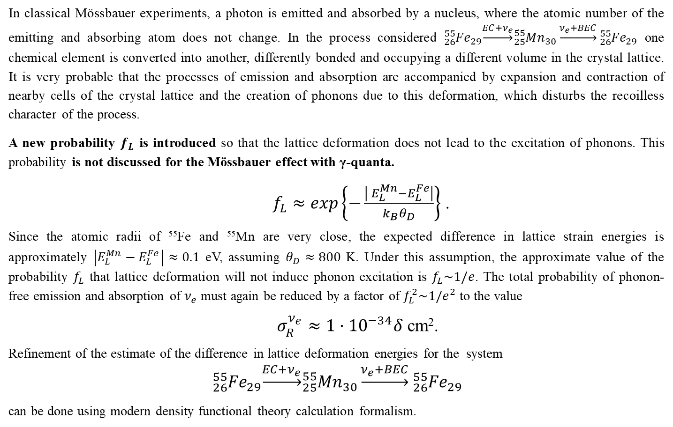
INSTITUTE FOR NUCLEAR RESEARCH AND NUCLEAR ENERGY
BULGARIAN ACADEMY OF SCIENCES
In classical Mössbauer experiments, a photon is emitted and absorbed by a nucleus, where the atomic number of the emitting and absorbing atom does not change. In the process considered ${{}_{26}^{55}{Fe}}_{29}\underset{→}{EC+ν_{e}}{{}_{25}^{55}{Mn}}_{30}\underset{→}{ν_{e}+BEC}{{}_{26}^{55}{Fe}}_{29}$ one chemical element is converted into another, differently bonded and occupying a different volume in the crystal lattice. It is very probable that the processes of emission and absorption are accompanied by expansion and contraction of nearby cells of the crystal lattice and the creation of phonons due to this deformation, which disturbs the recoilless character of the process.
A new probability $f_{L}$ is introduced so that the lattice deformation does not lead to the excitation of phonons. This probability is not discussed for the Mössbauer effect with γ-quanta.
$f_{L}≈exp\left\{−\frac{\left|{ E}_{L}^{Mn}−E_{L}^{Fe}\right|}{k_{B}θ_{D}}\right\}$ .
Since the atomic radii of ⁵⁵Fe and ⁵⁵Mn are very close, the expected difference in lattice strain energies is approximately $\left|E_{L}^{Mn}−E_{L}^{Fe}\right|≈0.1$ eV, assuming $θ_{D}≈800$ K. Under this assumption, the approximate value of the probability $f_{L}$ that lattice deformation will not induce phonon excitation is $f_{L}\sim 1/e$. The total probability of phonon-free emission and absorption of $ν_{e}$ must again be reduced by a factor of $f_{L}^{2}\sim 1/e^{2}$ to the value
$σ_{R}^{ν_{e}}≈1·{10}^{−34}δ$ cm².
Refinement of the estimate of the difference in lattice deformation energies for the system
$${{}_{26}^{55}{Fe}}_{29}\underset{→}{EC+ν_{e}}{{}_{25}^{55}{Mn}}_{30}\underset{→}{ν_{e}+BEC}{{}_{26}^{55}{Fe}}_{29}$$
can be done using modern density functional theory calculation formalism.

Slide 16
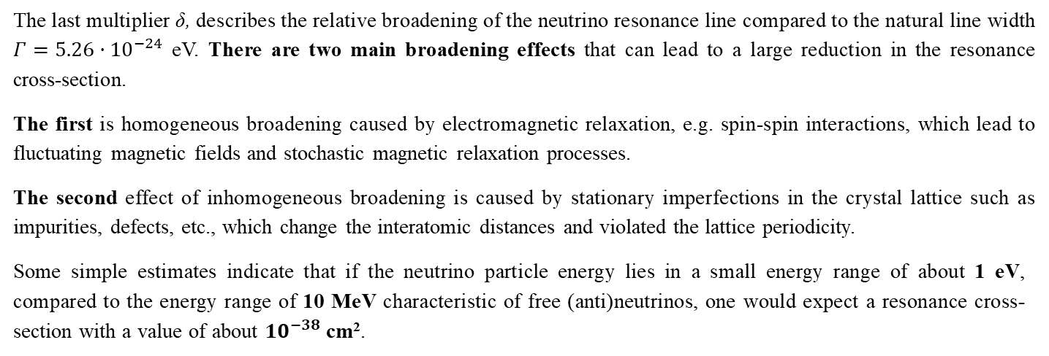
INSTITUTE FOR NUCLEAR RESEARCH AND NUCLEAR ENERGY
BULGARIAN ACADEMY OF SCIENCES
The resonance cross-section without momentum transfer and lattice excitation for bound electron capture (BEC) states
The last multiplier δ, describes the relative broadening of the neutrino resonance line compared to the natural line width $Γ=5.26·{10}^{−24}$ eV. There are two main broadening effects that can lead to a large reduction in the resonance cross-section.
The first is homogeneous broadening caused by electromagnetic relaxation, e.g. spin-spin interactions, which lead to fluctuating magnetic fields and stochastic magnetic relaxation processes.
The second effect of inhomogeneous broadening is caused by stationary imperfections in the crystal lattice such as impurities, defects, etc., which change the interatomic distances and violated the lattice periodicity.
Some simple estimates indicate that if the neutrino particle energy lies in a small energy range of about 1 eV, compared to the energy range of 10 MeV characteristic of free (anti)neutrinos, one would expect a resonance cross-section with a value of about ${10}^{−38}$ cm².

Slide 17
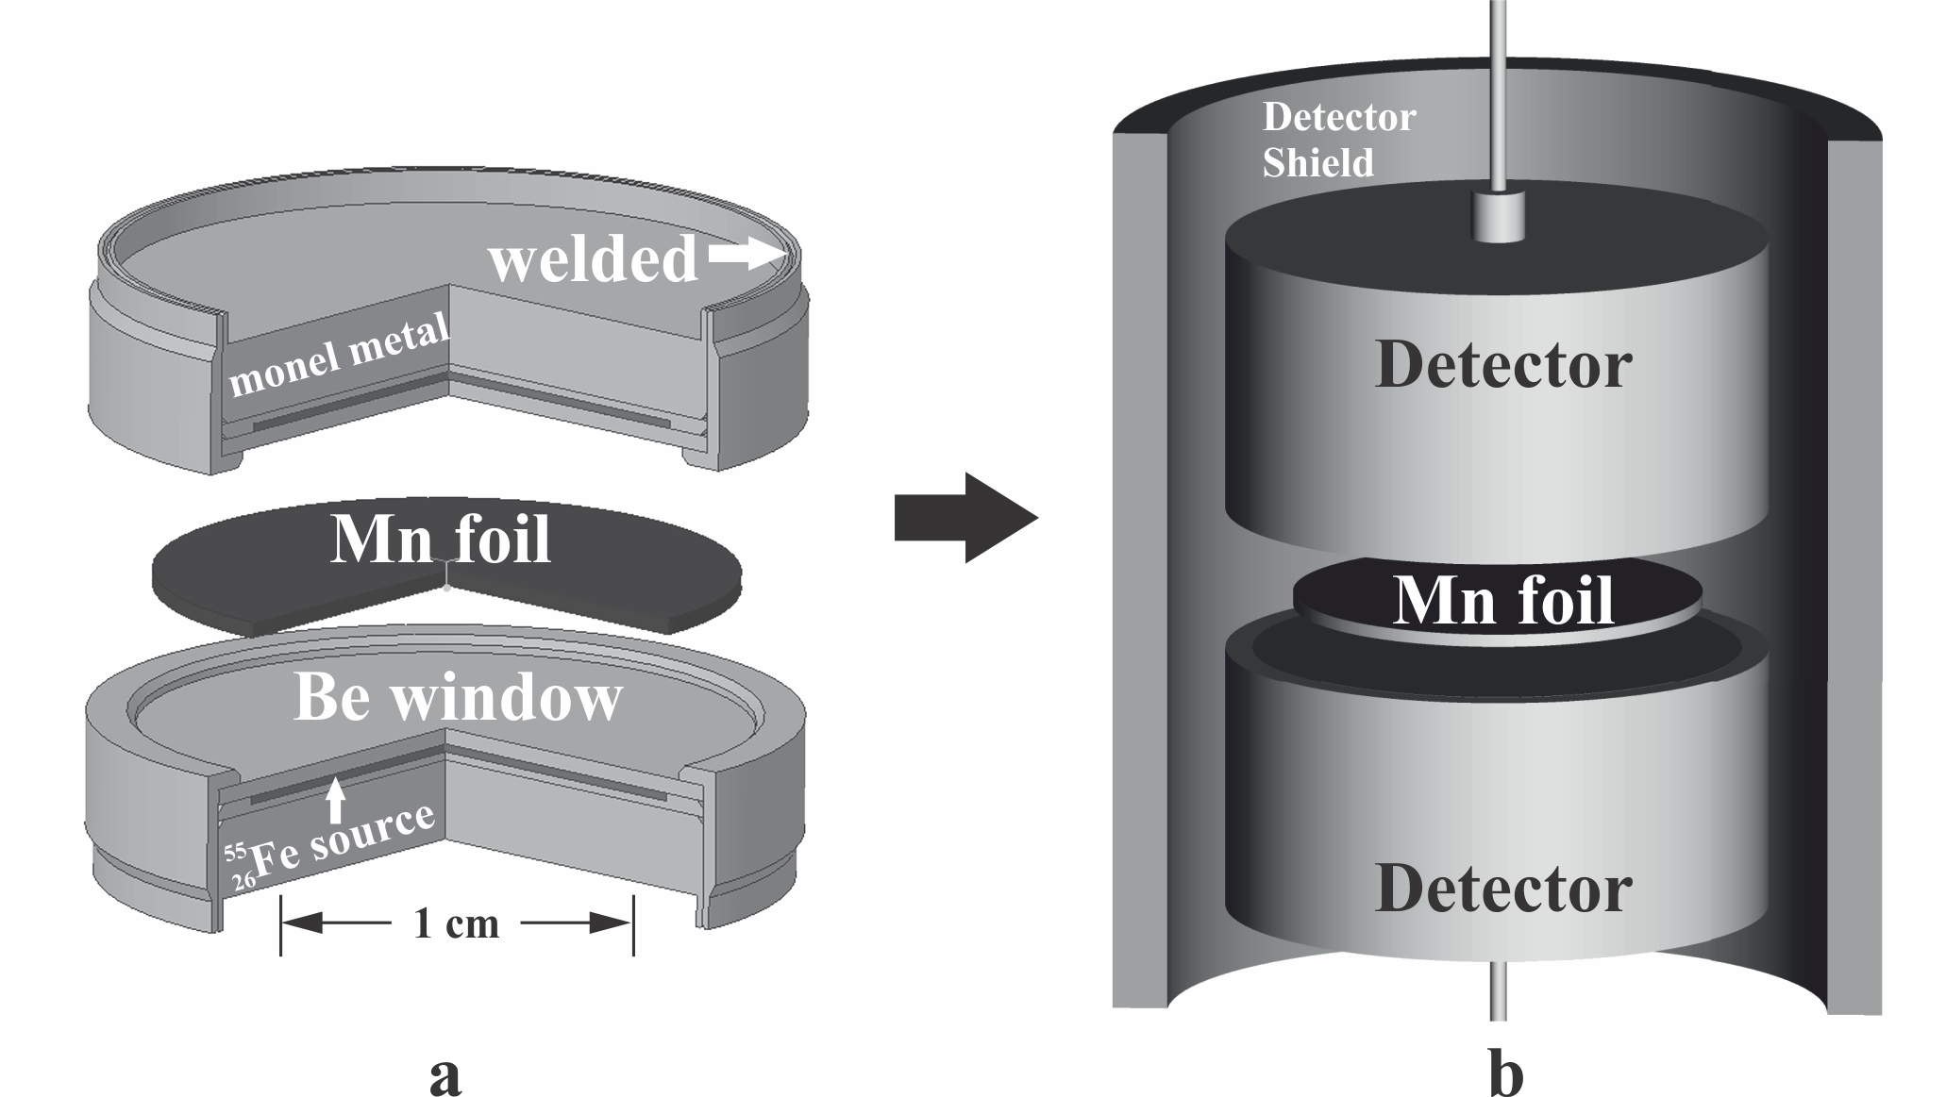
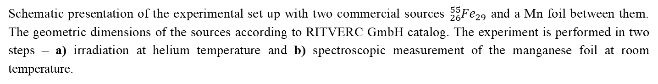
INSTITUTE FOR NUCLEAR RESEARCH AND NUCLEAR ENERGY
BULGARIAN ACADEMY OF SCIENCES
Schematic representation of an experiment for the detection of resonant Mössbauer neutrinos
Schematic presentation of the experimental set up with two commercial sources ${{}_{26}^{55}{Fe}}_{29}$ and a Mn foil between them. The geometric dimensions of the sources according to RITVERC GmbH catalog. The experiment is performed in two steps – a) irradiation at helium temperature and b) spectroscopic measurement of the manganese foil at room temperature.

Slide 18
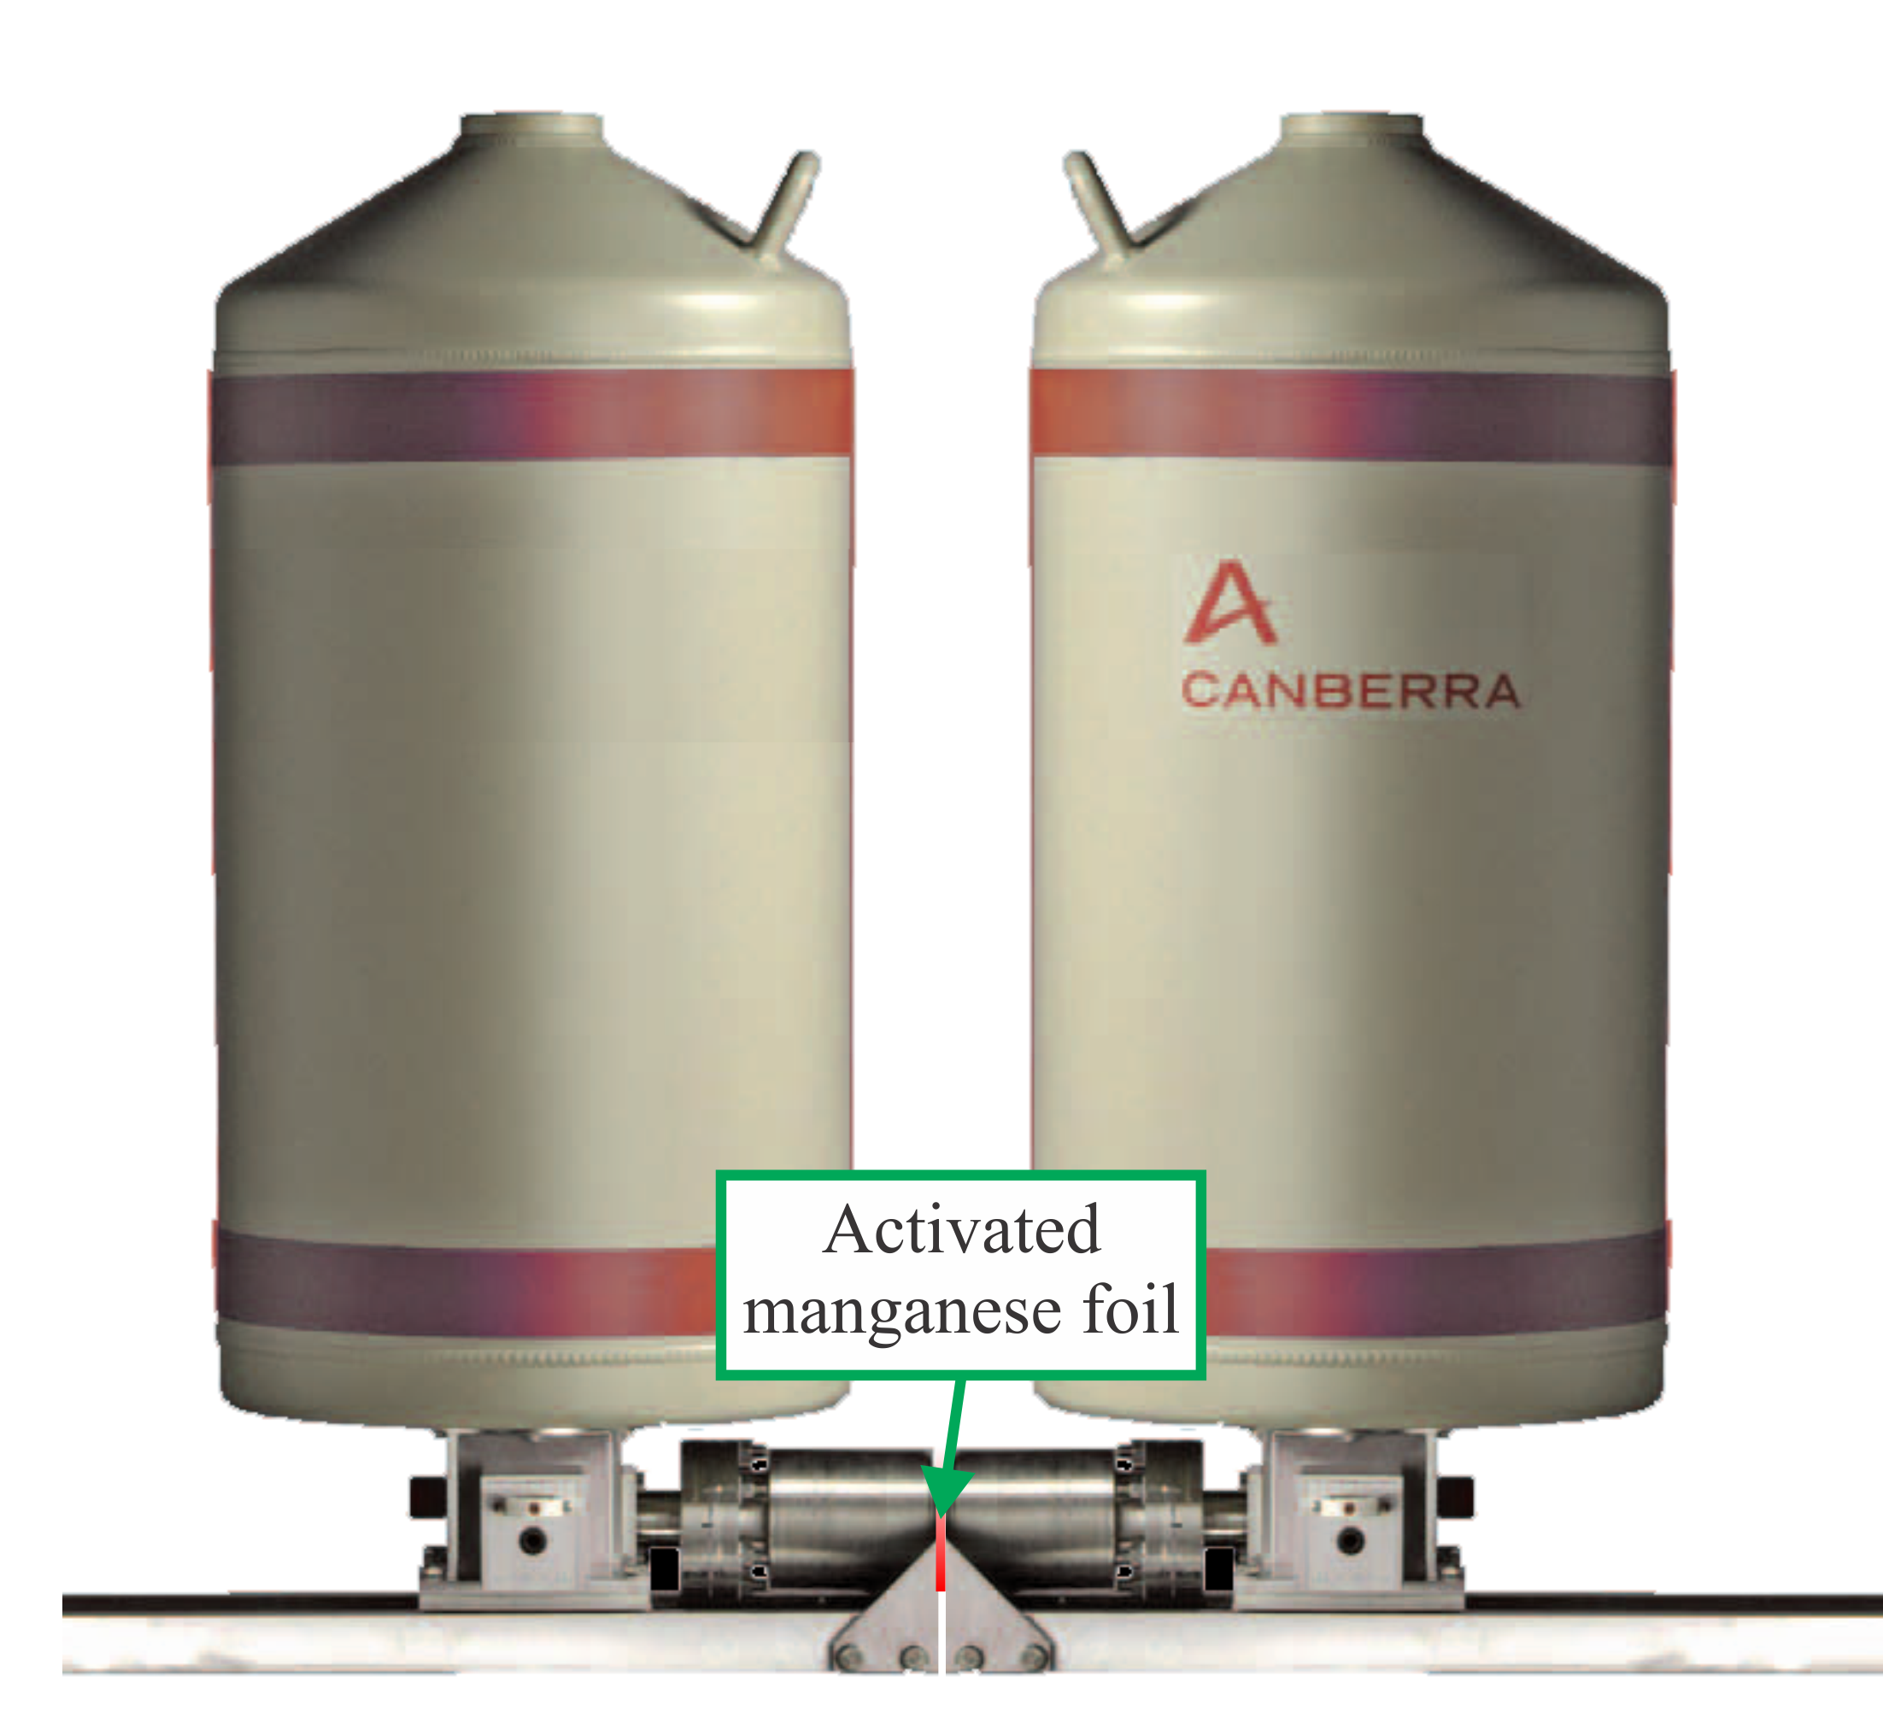
INSTITUTE FOR NUCLEAR RESEARCH AND NUCLEAR ENERGY
BULGARIAN ACADEMY OF SCIENCES
Low-energy X-ray radiation can be detected using semiconductor detectors with high energy resolution.

Slide 19
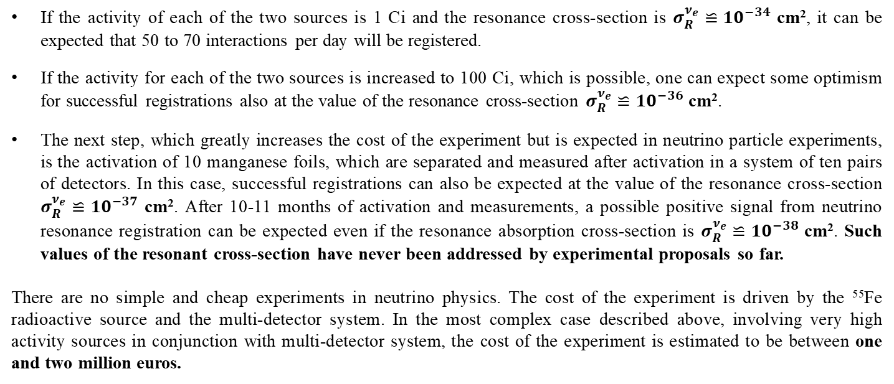
INSTITUTE FOR NUCLEAR RESEARCH AND NUCLEAR ENERGY
BULGARIAN ACADEMY OF SCIENCES
Expected experimental sensitivity
If the activity of each of the two sources is 1 Ci and the resonance cross-section is $σ_{R}^{ν_{e}}≌{10}^{−34}$ cm², it can be expected that 50 to 70 interactions per day will be registered.
If the activity for each of the two sources is increased to 100 Ci, which is possible, one can expect some optimism for successful registrations also at the value of the resonance cross-section $σ_{R}^{ν_{e}}≌{10}^{−36}$ cm².
The next step, which greatly increases the cost of the experiment but is expected in neutrino particle experiments, is the activation of 10 manganese foils, which are separated and measured after activation in a system of ten pairs of detectors. In this case, successful registrations can also be expected at the value of the resonance cross-section $σ_{R}^{ν_{e}}≌{10}^{−37}$ cm². After 10-11 months of activation and measurements, a possible positive signal from neutrino resonance registration can be expected even if the resonance absorption cross-section is $σ_{R}^{ν_{e}}≌{10}^{−38}$ cm². Such values of the resonant cross-section have never been addressed by experimental proposals so far.
There are no simple and cheap experiments in neutrino physics. The cost of the experiment is driven by the ⁵⁵Fe radioactive source and the multi-detector system. In the most complex case described above, involving very high activity sources in conjunction with multi-detector system, the cost of the experiment is estimated to be between one and two million euros.

Slide 20
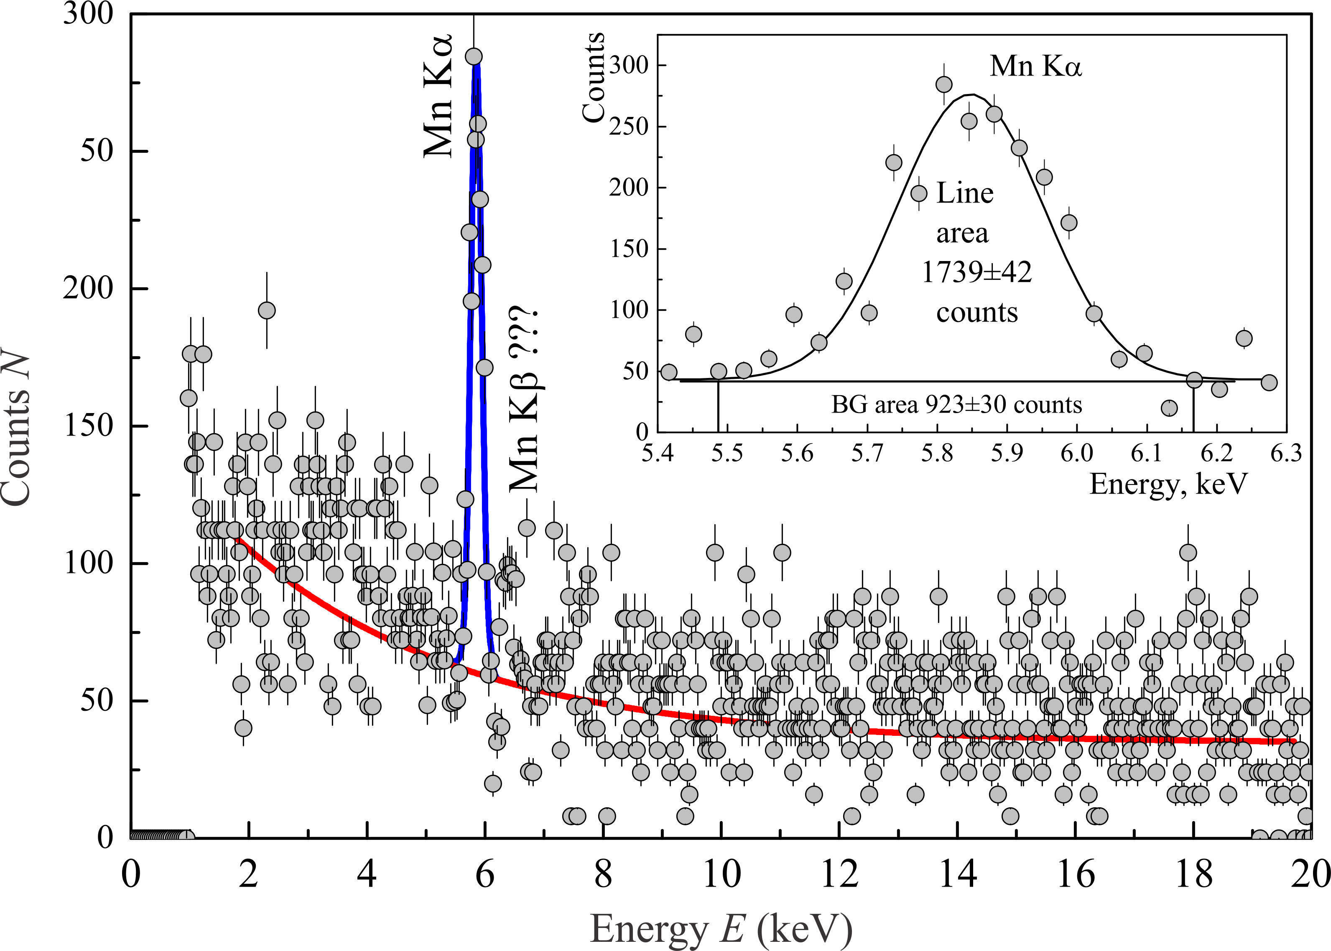
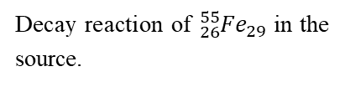




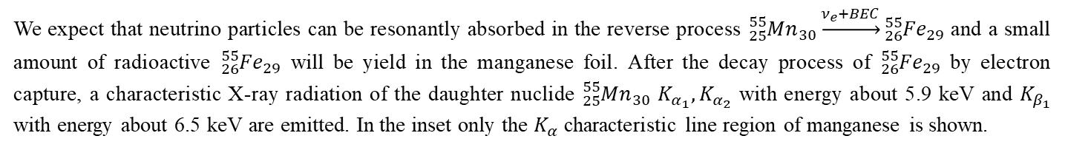
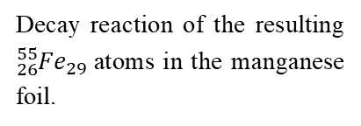
INSTITUTE FOR NUCLEAR RESEARCH AND NUCLEAR ENERGY
BULGARIAN ACADEMY OF SCIENCES
Decay reaction of ${{}_{26}^{55}{Fe}}_{29}$in the source.
$${{}_{26}^{55}{Fe}}_{29}\underset{→}{EC}{{}_{25}^{55}{Mn}}_{30}+ν_{e}$$
Neutrino-induced activation reaction of the manganese foil.
$${{}_{25}^{55}{Mn}}_{30}+ν_{e}\underset{→}{BEC}{{}_{26}^{55}{Fe}}_{29}$$
Decay reaction of the resulting ${{}_{26}^{55}{Fe}}_{29}$atoms in the manganese foil.
$${{}_{26}^{55}{Fe}}_{29}\underset{→}{EC}{{}_{25}^{55}{Mn}}_{30}^{∗}+ν_{e}$$
Emission of characteristic X-ray radiation from the excited manganese atoms.
${{}_{25}^{55}{Mn}}_{30}^{∗}→{{}_{25}^{55}{Mn}}_{30}$+ $K_{α}$
We expect that neutrino particles can be resonantly absorbed in the reverse process ${{}_{25}^{55}{Mn}}_{30}\underset{→}{ν_{e}+BEC}{{}_{26}^{55}{Fe}}_{29}$ and a small amount of radioactive ${{}_{26}^{55}{Fe}}_{29}$ will be yield in the manganese foil. After the decay process of ${{}_{26}^{55}{Fe}}_{29}$ by electron capture, a characteristic X-ray radiation of the daughter nuclide ${{}_{25}^{55}{Mn}}_{30}$ $K_{α_{1}}{, K}_{α_{2}}$ with energy about 5.9 keV and $K_{β_{1}}$ with energy about 6.5 keV are emitted. In the inset only the $K_{α}$ characteristic line region of manganese is shown.

Slide 21
INSTITUTE FOR NUCLEAR RESEARCH AND NUCLEAR ENERGY
BULGARIAN ACADEMY OF SCIENCES
The successful implementation of such an experiment by a Bulgarian research team, even within the framework of an international collaboration, would serve as a strong affirmation of the leading role of the Institute for Nuclear Research and Nuclear Energy at the Bulgarian Academy of Sciences in the advancement of global nuclear physics.
This work was awarded first place in the competition dedicated to May 24, 2024, for the best scientific achievement of INRNE–BAS in the thematic area “Applied Research in Nuclear Physics”.
The research has been supported by the Bulgarian National Science Fund under Contract No KP-06-N77/1, 28.11.2023 and the National Roadmap for Research Infrastructure 2020–2027 for the National Cyclotron Centre funded by the Bulgarian Ministry of Education and Science.
THANK YOU FOR YOUR ATTENTION!

