Slide 1



Analysis of the coolant of small modular reactors based on liquid tin
(Анализ на топлоносителя на малки модулни реактори, базирани на течен калай)
Пламен Петков
Faculty of physics, Sofia University “St. Kliment Ohridski”
April 16, Grand Hotel "Sofia", Sofia, 2026

Slide 2
Outline of content
Prerequisites for development of STAR-PLUS(M)
Predesign of liquid metal fast small modular reactor and fundamentals including the updated version 2026
Substantiation of nuclear fuel
Thermohydraulic properties of core outline
Selection of liquid tin as a reactor coolant
Experimental setup for investigation of liquid tin properties and measurements
Updating of the experimental setup
Enhansing of measuring capacity

Slide 3
Description of STAR-PLUS(M) Fundamentals
Secure Transportable Autonomous Reactor (STAR) - Liquid Metal (LM) fast reactor
STAR-LM, Pb-Bi/water, G-IV of 300/400 MWt, with steam generators
PBWR direct heat transfer, Pb-Bi/water (MIT), converted to steam directly mixed with the liquid metal coolant
Adopted reduced Core diameter/height from 2.5/2.0 m of STAR-LM to 1.02/0.8 m in SSTAR in order to fulfil the task of safe and affordable energy supply
Revised secondary coolants: STAR-LM concept considered of water/steam cycle and SSTAR designed with supercritical carbon dioxide, operated at pressure of 20 MPa
Analyzed considered intermediate circuit of SSTAR for partial mixing of S-CO₂ with liquid lead (Pb).
SSTAR power output, is 20 MWe, Pb/S-CO₂, with heat exchangers
Current predesign based on STAR concept: STAR-PLUS(M), 7.2 MWe
Elliott’s Li/water MHD conversion system where Li accelerated in a nozzle, separated from the vapor in a separator and decelerated by the production of electric power
Petkov et al., 2022

Slide 4
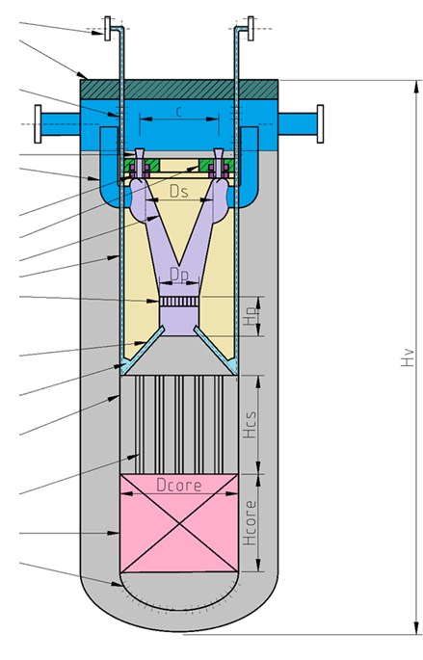
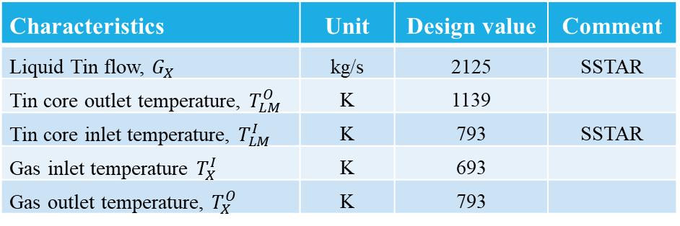
Predesign of liquid metal fast small modular reactor 2022
gas entrance pipe system
upper supporting plate
upper perforation through the core barrel
Protection against radioactive releases:
First protective barrier provided by the enhanced features of nitride (UN) fuel
secondary protective barrier provided by fuel confining structures.
The reactor vessel is functioning not only as coolant holder but also of third barrier
secondary vessel is fourth protective barrier with additional passive cooling
liquid metal outlet diffuser
nitrogen through the gas separator
Hot gas outlet
magnets
magnet core
nozzle
gas transport pipes
parallel channels
system of perforated pipes, supplying the nitrogen in liquid pump
gas collector
core barrel
Characteristics | Unit | Design value | Comment
Liquid Tin flow, $G_{X}$ | kg/s | 2125 | SSTAR
Tin core outlet temperature, $T_{LM}^{O}$ | K | 1139
Tin core inlet temperature, $T_{LM}^{I}$ | K | 793 | SSTAR
Gas inlet temperature $T_{X}^{I}$ | K | 693
Gas outlet temperature, $T_{X}^{O}$ | K | 793
reactivity controlling system
reactor core
elliptical bottom perforation
Petkov et al., 2022

Slide 5
STAR-PLUS(M) thermal cycle outline
MHD1G01: Magnetohydrodynamic electrical generator
TN01C01: Separator, where the gaseous nitrogen is separated from liquid tin
PU01P01: Heated liquid metal gas driven pump
PU01M01: Gaseous nitrogen injection bubble pump
RC01E01: Reactor core, where the coolant is heated
NC01P01: Compressor for gaseous nitrogen;
NE01E0: External heat exchanger for final heat removal from the loop
Petkov et al., 2026

Slide 6
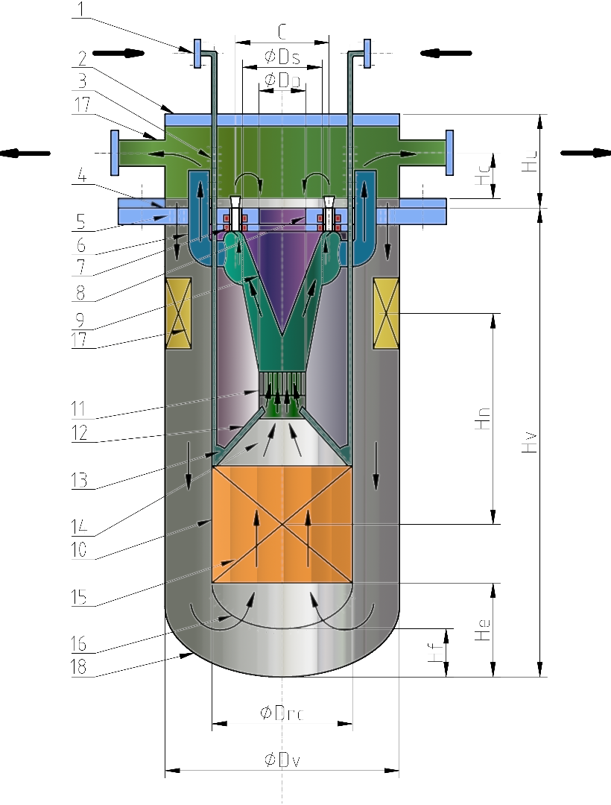
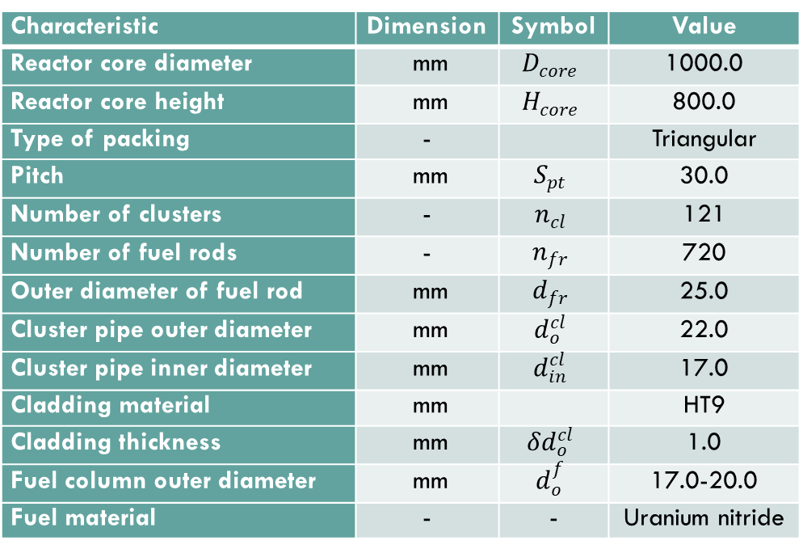
design of liquid metal fast small modular reactor 2026
Cold gas inlet
Hot gas outlet
Characteristic | Dimension | Symbol | Value
Reactor core diameter | mm | $$D_{core}$$ | 1000.0
Reactor core height | mm | $$H_{core}$$ | 800.0
Type of packing | - |  | Triangular
Pitch | mm | $$S_{pt}$$ | 30.0
Number of clusters | - | $$n_{cl}$$ | 121
Number of fuel rods | - | $$n_{fr}$$ | 720
Outer diameter of fuel rod | mm | $$d_{fr}$$ | 25.0
Cluster pipe outer diameter | mm | $$d_{o}^{cl}$$ | 22.0
Cluster pipe inner diameter | mm | $$d_{in}^{cl}$$ | 17.0
Cladding material | mm |  | HT9
Cladding thickness | mm | $${δd}_{o}^{cl}$$ | 1.0
Fuel column outer diameter | mm | $$d_{o}^{f}$$ | 17.0-20.0
Fuel material | - | - | Uranium nitride
Petkov et al., 2022

Slide 7
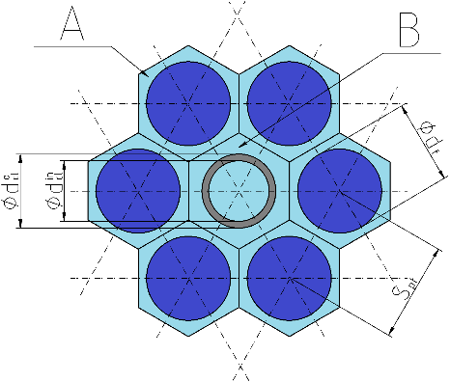

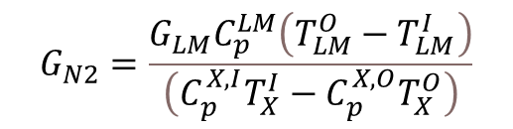
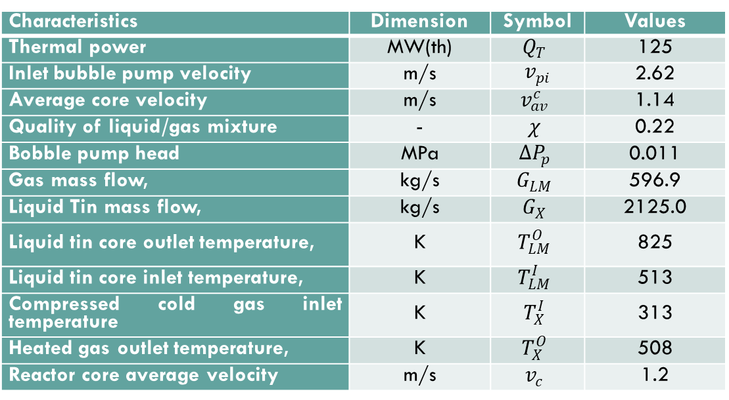
Reactor core hydraulic system: core cross-sectional view and a fuel cluster.
Characteristics | Dimension | Symbol | Values
Thermal power | MW(th) | $$Q_{T}$$ | 125
Inlet bubble pump velocity | m/s | $v_{pi}$ | 2.62
Average core velocity | m/s | $$v_{av}^{c}$$ | 1.14
Quality of liquid/gas mixture | - | $$χ$$ | 0.22
Bobble pump head | MPa | $${ΔP}_{p}$$ | 0.011
Gas mass flow, | kg/s | $$G_{LM}$$ | 596.9
Liquid Tin mass flow, | kg/s | $$G_{X}$$ | 2125.0
Liquid tin core outlet temperature, | K | $$T_{LM}^{O}$$ | 825
Liquid tin core inlet temperature, | K | $$T_{LM}^{I}$$ | 513
Compressed cold gas inlet temperature | K | $$T_{X}^{I}$$ | 313
Heated gas outlet temperature, | K | $$T_{X}^{O}$$ | 508
Reactor core average velocity | m/s | $$v_{c}$$ | 1.2
Liquid metal flow rate
Liquid metal specific heat capacity
Pump outlet temperature
Core outlet temperature
Required N₂ flow rate
$$G_{N2}=\frac{G_{LM}C_{p}^{LM}\left(T_{LM}^{O}−T_{LM}^{I}\right)}{\left(C_{p}^{X,I}T_{X}^{I}−C_{p}^{X,O}T_{X}^{O}\right)}$$
Petkov et al., 2026
N₂ inlet enthalpy
N₂ outlet enthalpy

Slide 8
NUCLEAR FUEL
Petkov et al., 2022
The most popular currently nuclear fuel UO₂ with melting point 3118 ± 25 K
Nitride fuel (NU) with similar melting point: 3120 ± 30 K fabricated and tested in sodium cooled BR-10, FFTF and EBR-II nuclear reactors
Increased fissile density by 40% compared to UO₂, which could increase the burn-ups.
Improved thermal conductivity leading to fuel centerline temperature decreasing, which allows to be increased the core outlet temperatures and increasing the margins for fuel melting
Fuel reprocessing is greatly improved by application of PUREX process (involves HNO₃ for dissolution of spent fuel)
Fuel possesses enhanced chemical compatibility with the most potential cladding materials and a radiation stability.
The duration of fuel cycle without reloading is increased with corresponds to non-proliferation policy.
Advantages
Oxidizes in 0.50 bars superheated steam with complete degradation for one hour at 500℃ which significantly questions the any form of oxygen presences in the reactor system.
The just prepared nitride powder require special oxygen free environment because is pyrophoric and will react immediately with the oxygen from the environmental air
Nitrogen must be enriched in ¹⁵N in order to increase the fuel economy and to avoid (n, p) reaction to ¹⁴C from ¹⁴N (in addition to the mixing gas coolant) that enhance the amount of radioactive waste
Drawbacks

Slide 9
Selection of Liquid tin as core heat removal coolant
Low melting point of tin in comparison with lead allows the inlet temperature of a coolant to increase of the operational range
Effective heat removal up to 1 GW/m3 below 600°C with coolant flow velocity below 5 m/s, due to the favorable thermal and physical properties of tin
Estimated radioactivity of tin as well as bismuth-lead is high enough after irradiation with 400 MeV proton flux of 5×10¹³ proton/cm² s for a year to require a significant cooling time to decrease target activities to the acceptable hands-on level of 10⁸ Bq/kg for beta-active nuclides
Tin target may also compete with lead target as an effective proton-to-neutron converter where Sn-124 (~6 percent in the natural mixture) enhance the neutron yield
A complete absence of alpha emitters in the radioactive wastes of tin makes it less radiotoxic material than lead or bismuth-lead (Po-210, Pb-202)
The most severe disadvantage: aggressive interactions with the other structural materials, used currently in nuclear technology
Usable with graphite (C), Tungsten (W), Molybdenum (Mo), Rhenium (Re) and below 773 K with Chromium (Cr) and with Iron (Fe)
Tin is relatively cheap material that could be found in sufficient quantity
Petkov et al., 2022

Slide 10
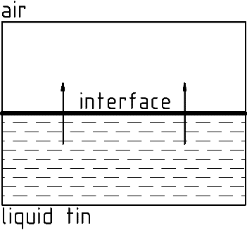

Tin-oxygen interaction
Above 543,4 K and higher concentration of O₂ the oxide SnO undergoes transition to Sn₃O₄
Ref. J. Leitner (2019)
SnO₂ forms at high temperatures and high concentrations of O₂
coexist liquid tin “γ” and solid SnO
Lyutov et al., 2023
Five steps of oxidation:
Sn atoms reduction at the surface
Electron diffusion upwards the surface
O₂ gas molecules adsorption at the surface
SnO solid phase formation at the interface
Initially only SnO solid phase is formed at the surface
coexist liquid tin “γ” and solid SnO

Slide 11
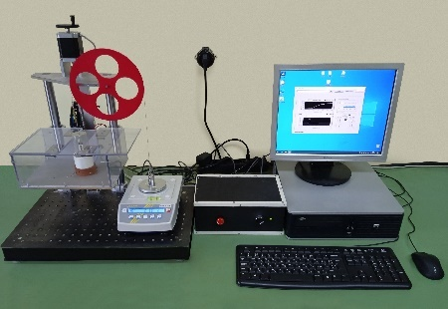
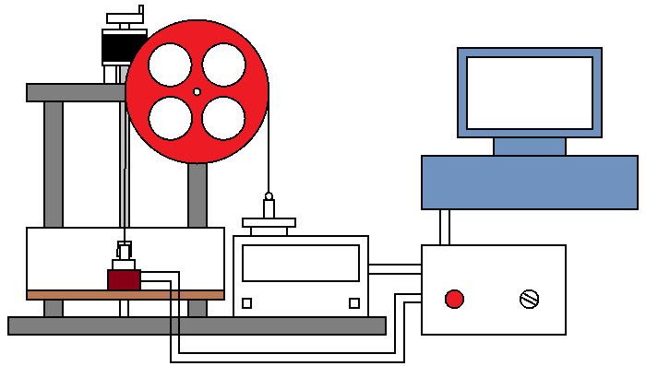
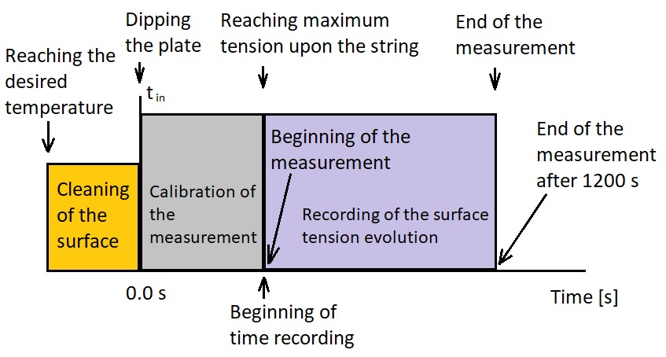
Experimental setup and procedure 2023
pulley
non-expanding string
stepper motor
scale
data acquisition module
Luytov et al., 2023
supporting stand
non-expanding string
Wilhelmy plate
heating bed
heater
Z-axis stage
Module for temperature control
PC for data acquisition
supporting table
Experimental procedure

Slide 12
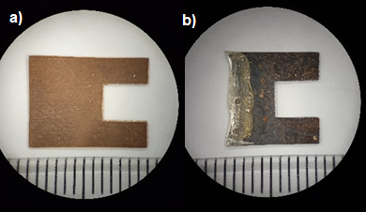
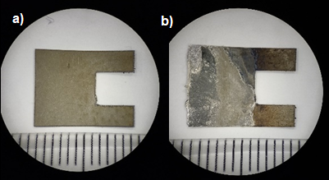
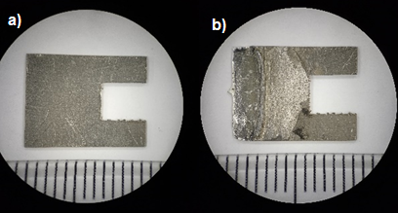
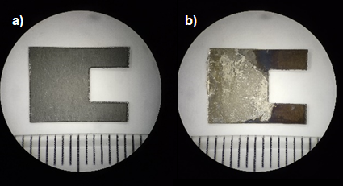
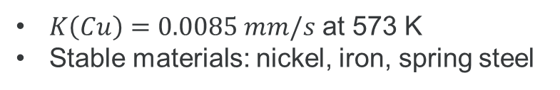

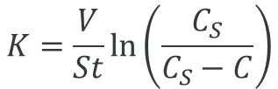
Investigation of solid materials stability
Two series of measurement (5h) and (8h) at 573 K
Copper plate → severe dissolution
$K\left(Cu\right)=0.0085 mm/s$ at 573 K
Stable materials: nickel, iron, spring steel
Lyutov et al., 2023
copper
iron
Density of the melt
$$ρ_{melt}=ρ_{Sn}C_{Sn}+ρ_{sol}C_{sol}$$
density of tin
fractional concentrations
density of dissolved material
spring steel
nickel
Solution rate constant
volume
concentration of saturated melt
$$K=\frac{V}{St}ln⁡\left(\frac{C_{S}}{C_{S}−C}\right)$$
concentration
area
time

Slide 13
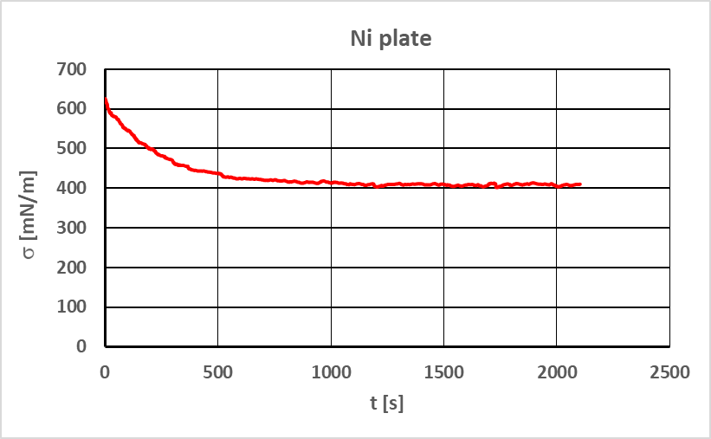
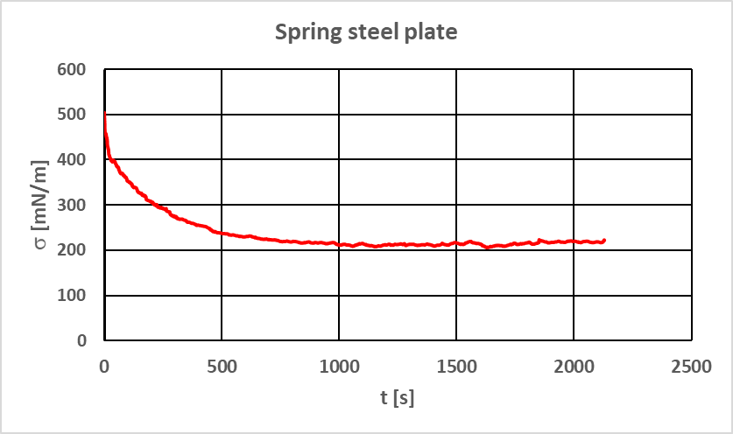
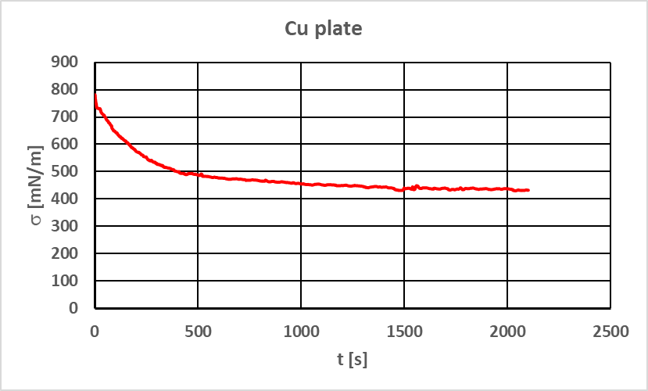
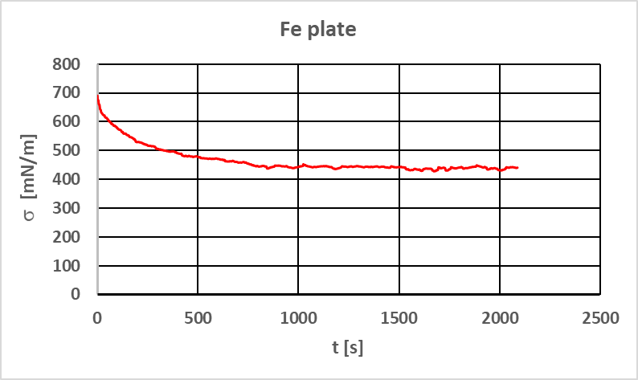
Surface tension evolution with time
Lyutov et al., 2023
Test measurements at temperature 325 C (598 K) (no phase transition at this temperature)

Slide 14
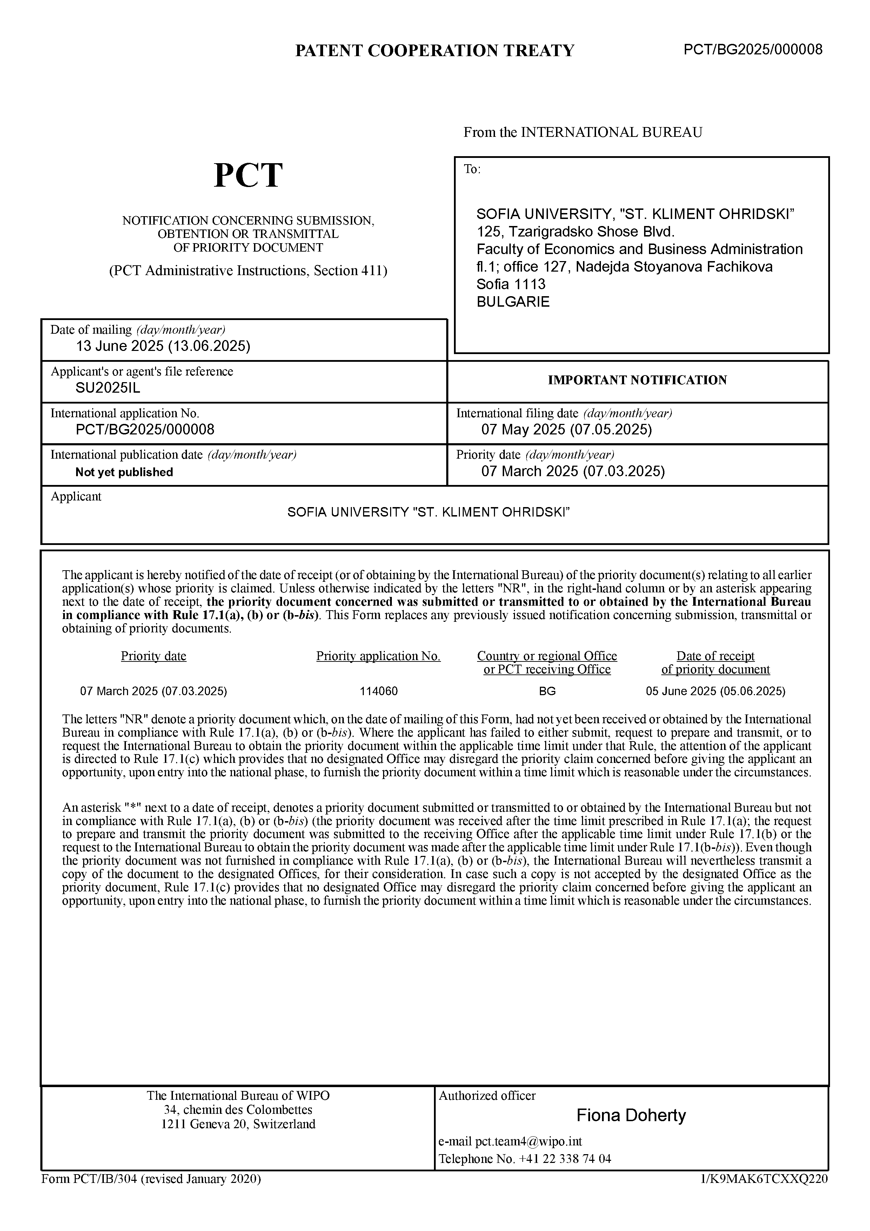
Enhancing measuring capacity
measurement of the interaction between a solid measuring probe with liquid metal sample in a controlled gas environment and a controlled temperature gradient, by directly measuring the tensile force and synchronously recording the processes with a fast optical camera.
determination of the two-phase and three-phase surface tension and contact angles of liquid metal samples and alloys with low melting temperature.
study of surface adsorption at temperatures higher than the melting point.
determining the coefficient of erosion/corrosion at different temperatures and determining the resistance of structural materials to liquid metals.
EU Patent submission, SUMMIT, 2025

Slide 15



This work is supported by Sofia University “St. Kliment Ohridski” SUMMIT, №. 70-123-663/16.04.2024
PLAMEN V. PETKOV DIMITAR LYUTOV HRISTO ILIEV BOYAN TODOROV NASKO GORUNSKI
Project Leader
SUMMIT Participants
STUDENTS CONTRIBUTING:
NIKOL BORISOVA
SPASKA NIKOLOVA
TODOR STEFANOV
VESELA NESTOROVA
PETAR TUHCHIEV
SONIA HAMMCHI
Thank you for the attention !!!

